Slide 1
Identifying immune cell subsets associated with immune-related adverse event (irAE) development
12-19-2024
Ty Bottorff – Bioinformatics postdoc
Linsley lab
1

Slide 2

Acknowledgements
Peter Linsley
Long lab/HIPcore
Alice Long, Alice Wiedeman
Holly Akilesh
Buckner lab
Jane Buckner, Sylvia Posso, Cliff Rims
Bernard Khor
Bioinformatics
Hannah DeBerg
Basilin Benson
Andrew Koval
Clinical teams at VM, SCCA, & the University of Texas
2

Slide 3
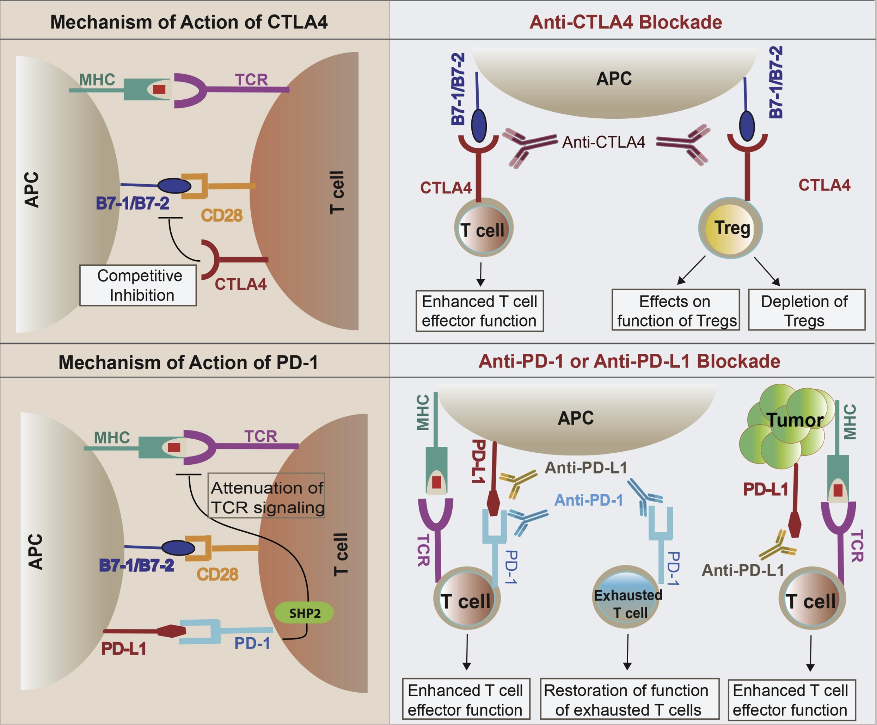
Immune checkpoint inhibitors (ICIs) have revolutionized cancer treatment
3
Khan et al. Semin Cancer Biol. 2020
Notes:
ICIs block inhibitory molecules that regulate T cells, releasing tumor-specific T cells to destroy tumor targets
Clinical success of ICI, but only effective in some patients (~20-50% response rates)

Slide 4
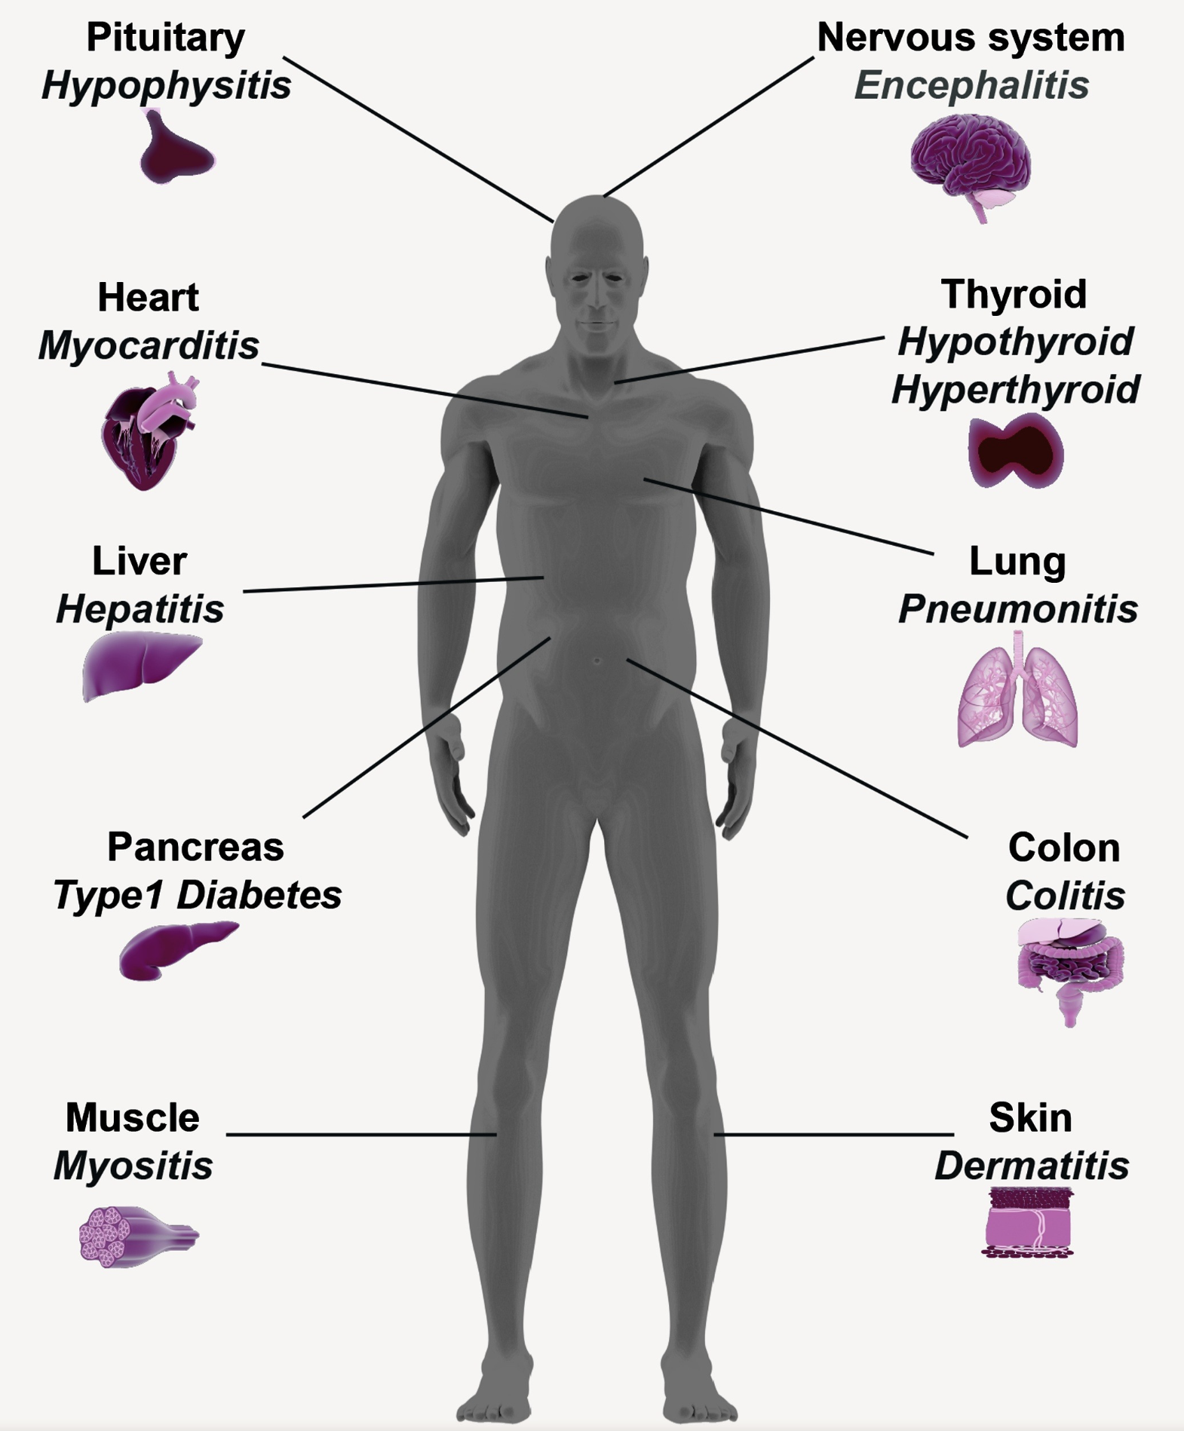
However, ICIs can lead to the development of immune-related adverse events (irAEs)
4
Khan et al. Semin Cancer Biol. 2020
Notes:
However, ICIs also release self-specific T cells to destroy self-targets (breach of self-tolerance), resulting in irAEs, autoimmune-like inflammatory pathologies (more transient, faster kinetics than autoimmune conditions)
irAEs are heterogeneous (organ-target), and have sometimes been associated with favorable response to ICI
irAEs affect quality of life AND can necessitate discontinuation of ICI which prevents full benefit of ICI therapy
heterogeneity amongst irAE organs likely complicates prediction
individuals with preexisting autoimmune disease flare when treated with ICI

Slide 5
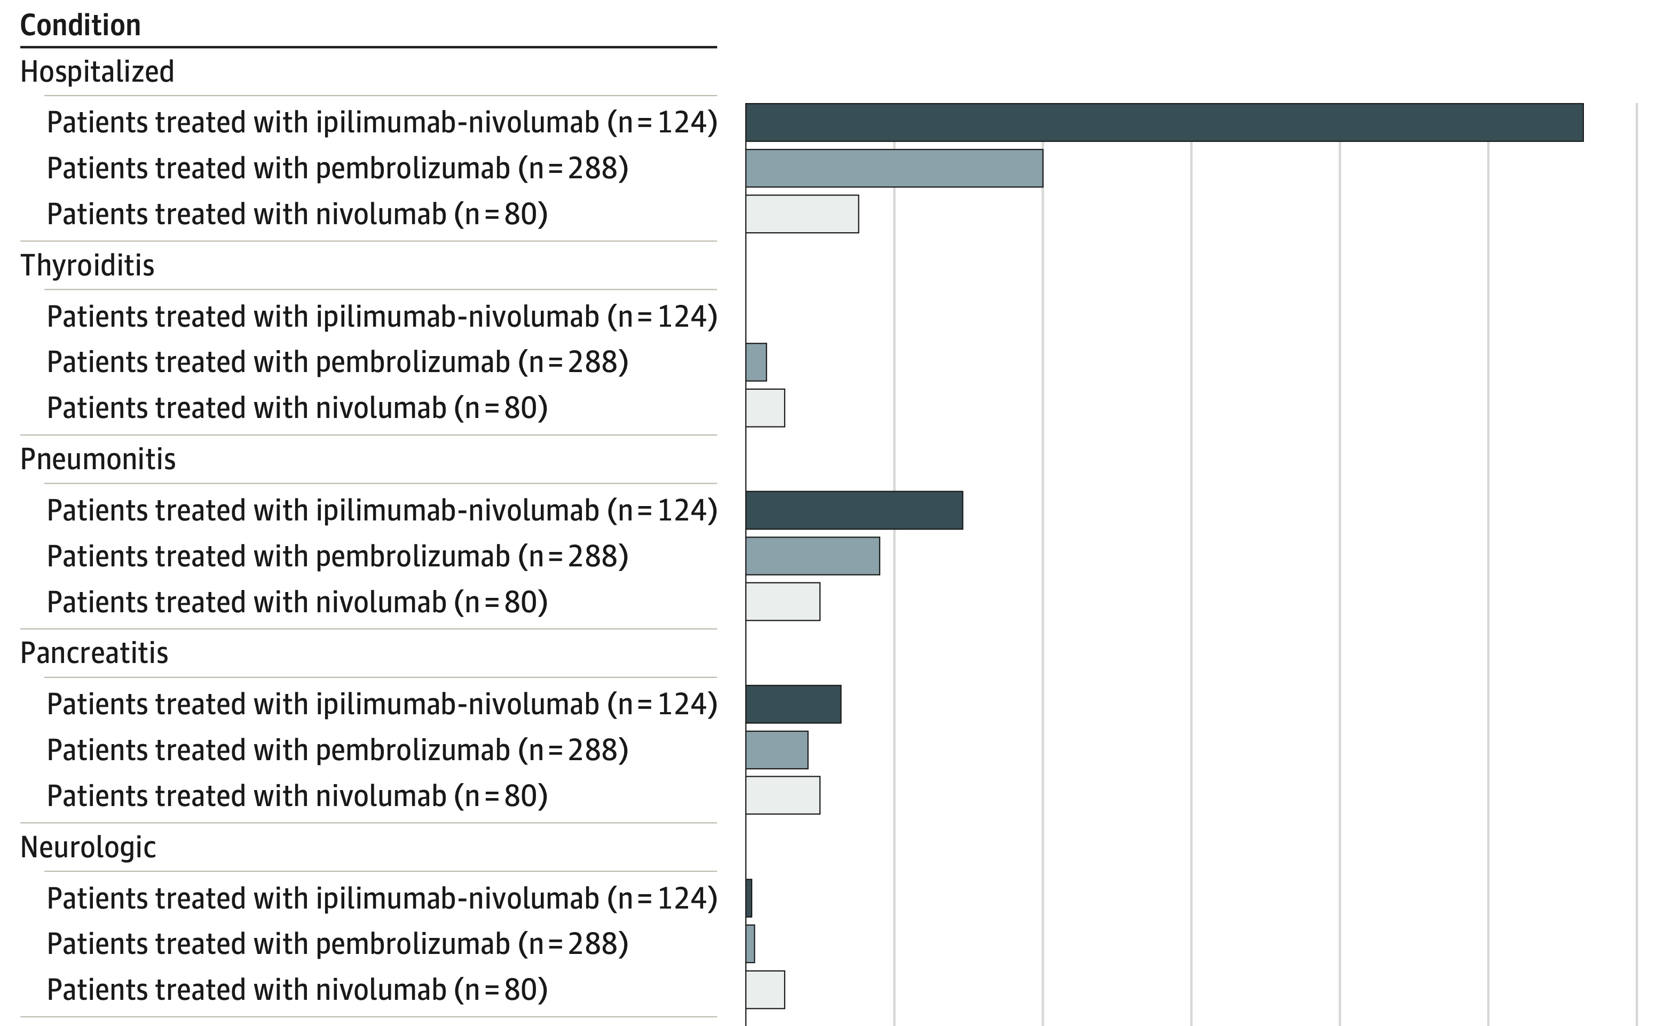
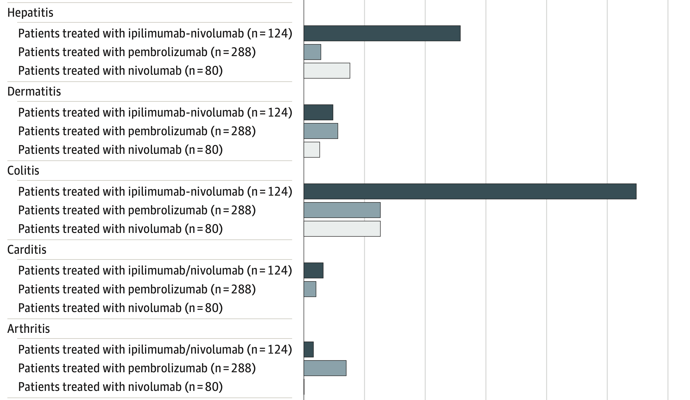
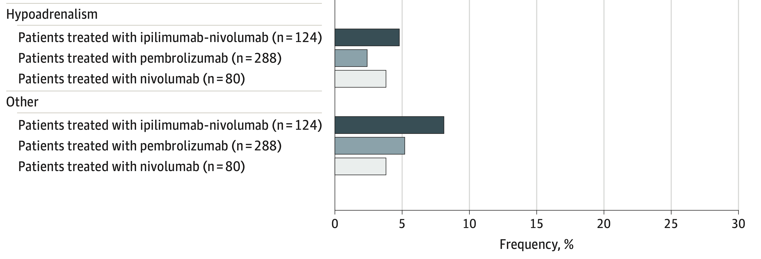
irAEs are rather common and can be severe
5
Watson et al. JAMA Netw Open. 2022
Notes:
Autoimmune toxicity occurs in up to 60% of patients treated with immune checkpoint inhibitor (ICI) therapy
Ipilimumab: CTLA-4
Pembrolizumab/nivolumab: PD-1

Slide 6
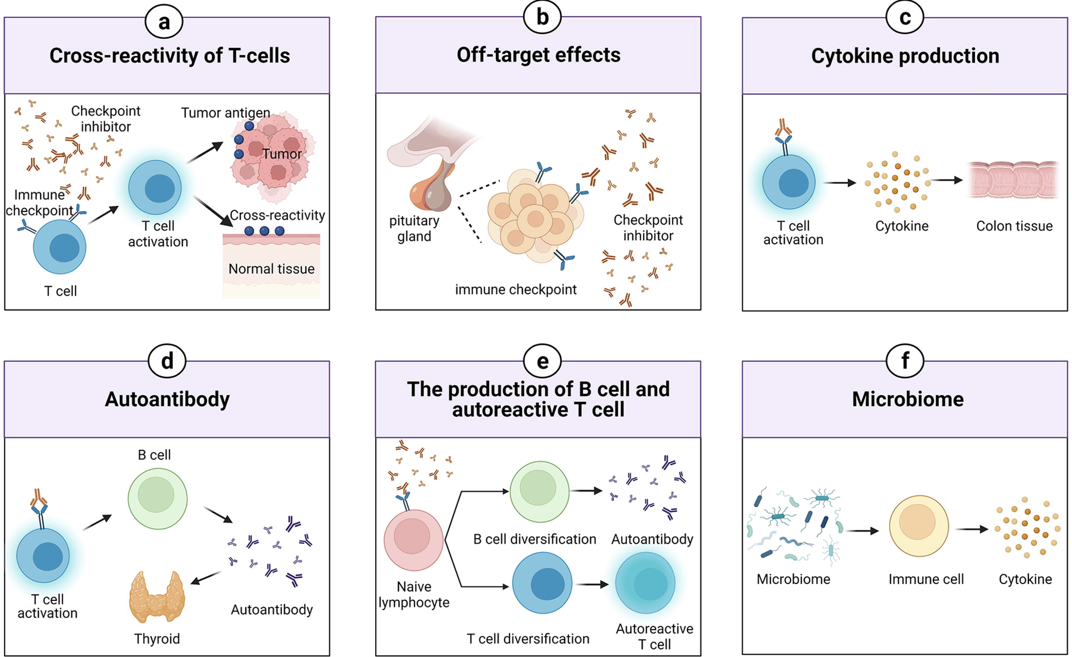
irAEs may be driven by multiple, possible mechanisms
6
Zheng et al. Materials & Design. 2022
Notes:
Shared antigens between tumor and self → cross-reactivity
Some tissues directly express immune checkpoint ligands (moreso for pituitary expression of CTLA-4)
Activated T cells can release inflammatory mediators that can damage normal tissues
Autoantibody production associated with irAE risk (autoantibodies present ~50% of time for irAEs)
ICIs can induce more diverse T/B cell repertoires as well as promote their activation/proliferation
T cells absolutely implicated in irAE development (clonal expansions of CD8s prior to severe irAEs)
Premise: T cell responses to tumor and autoantigens are predictive of response to ICI therapy and/or irAE, supported by 1) published studies showing that ICI therapy targets T cells and 2) emerging evidence that ICI therapy reverses T cell exhaustion
Certain microbiome species can shift immune response to pro/anti-inflammatory to induce/resist irAEs

Slide 7
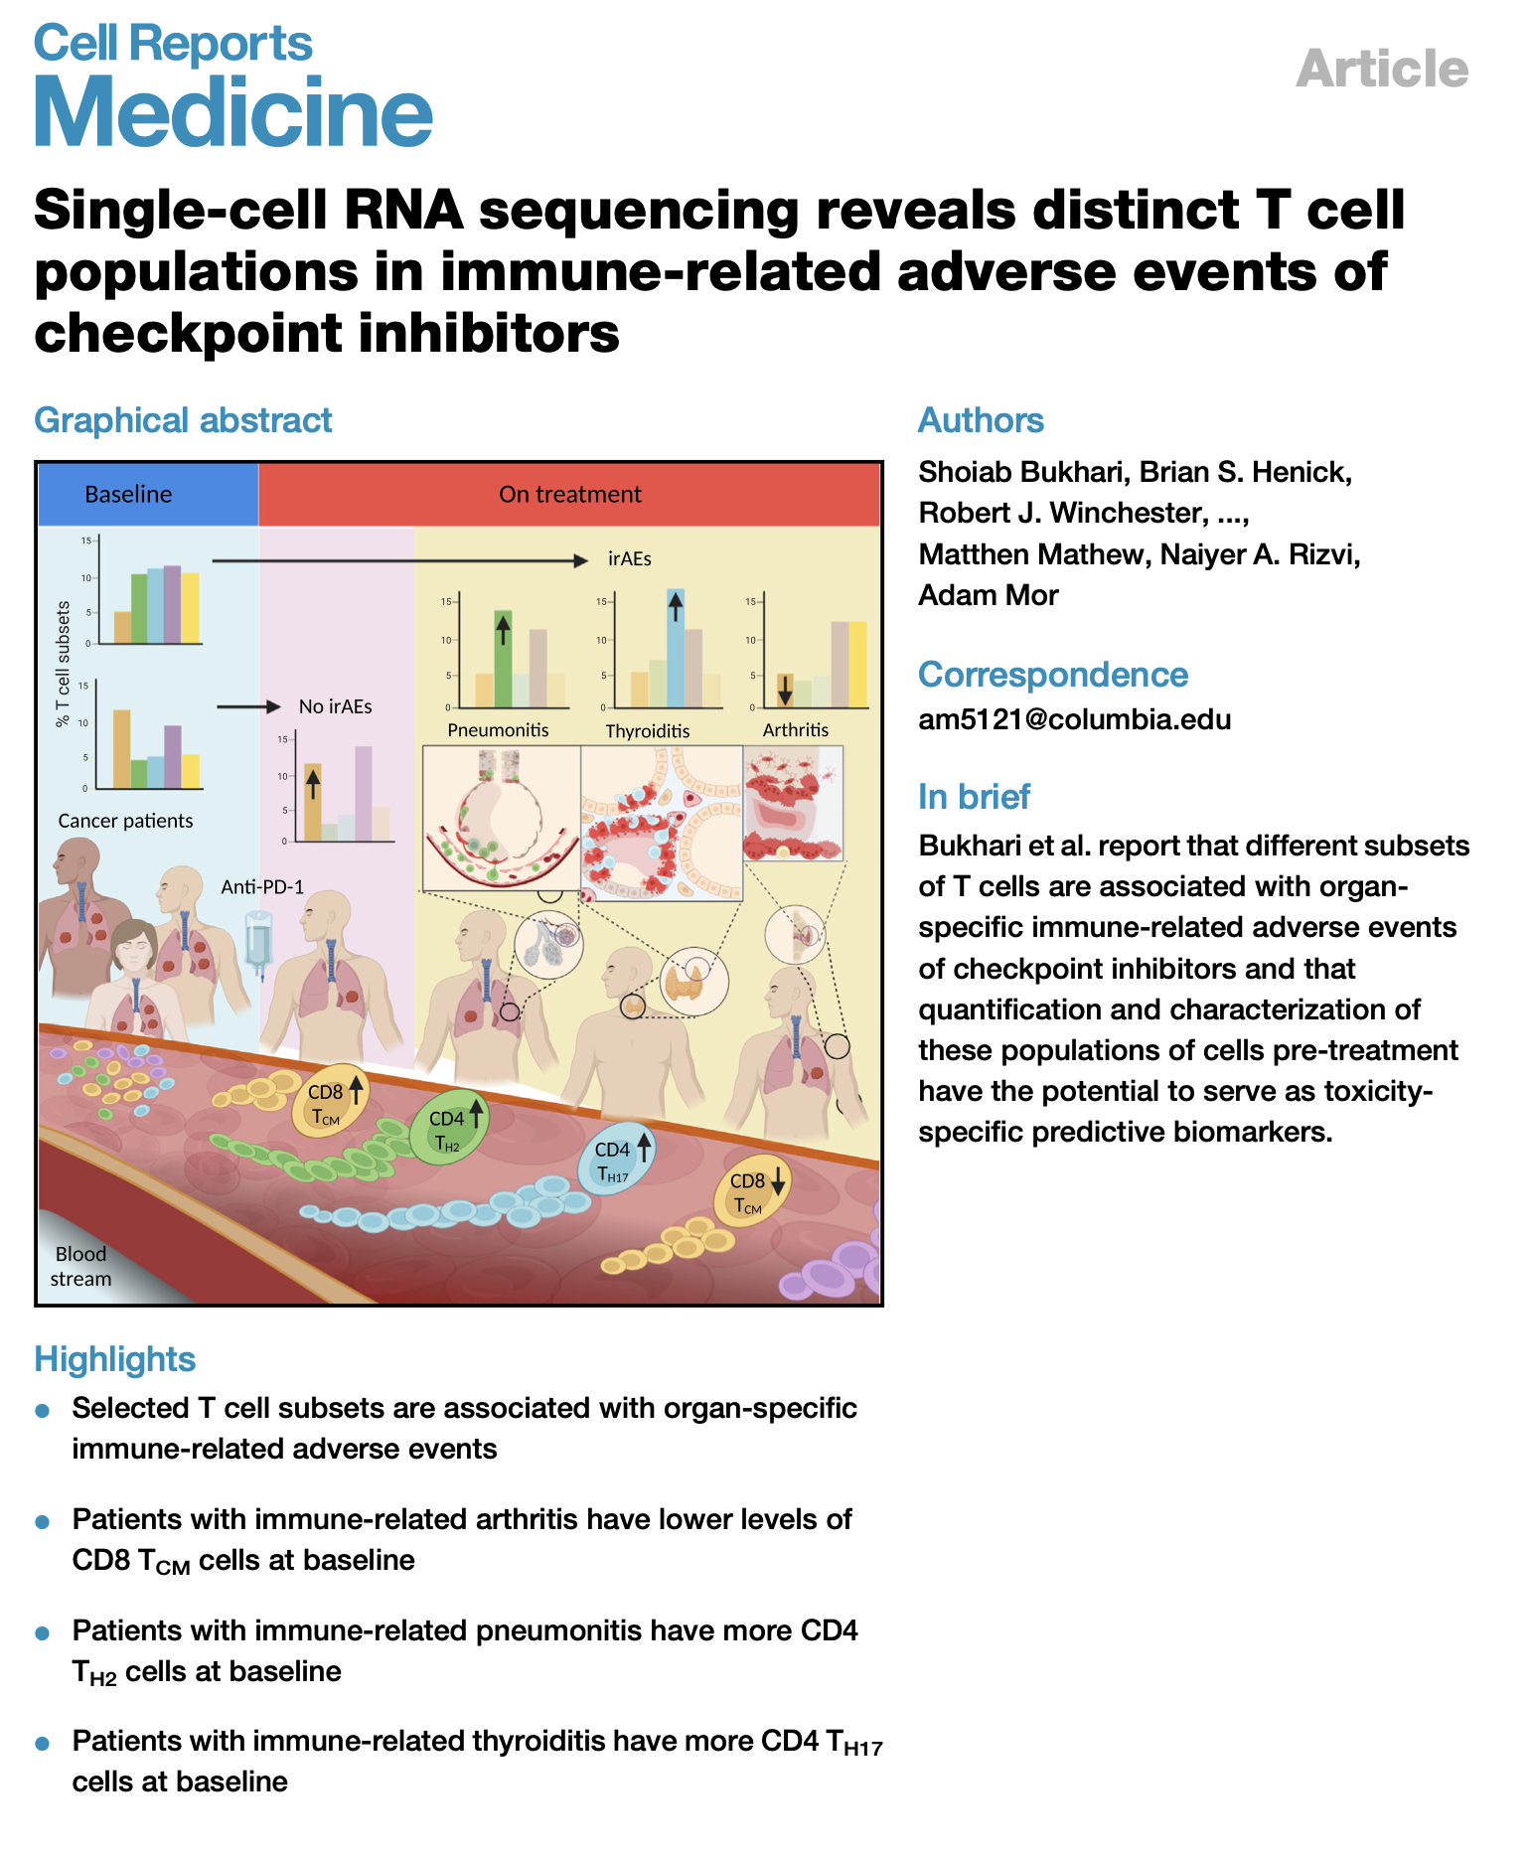
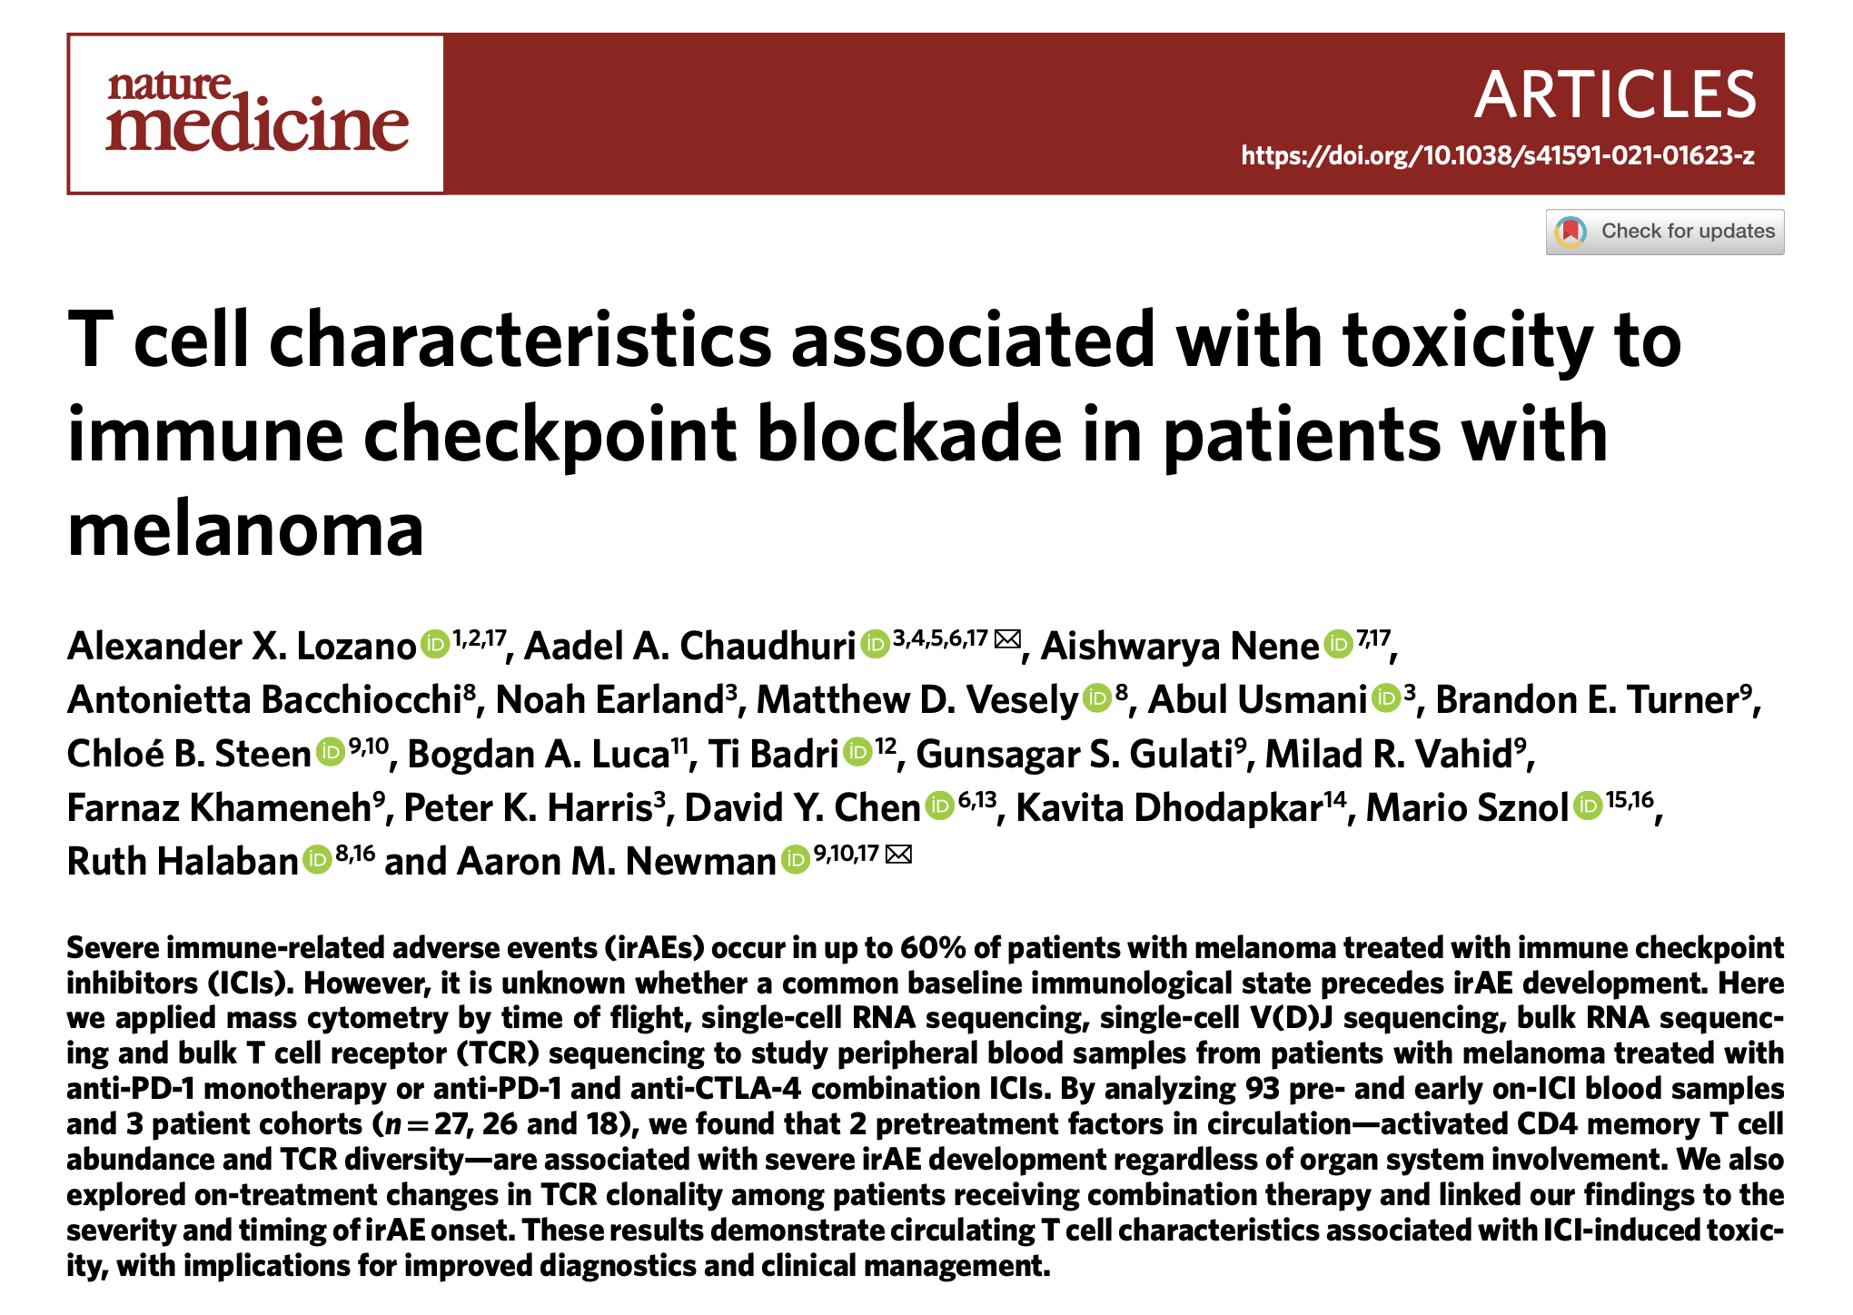
Baseline abundances of different T cell subsets have been associated with irAE development
7
Notes:
Literature has exploded since we started collecting samples
heterogeneity amongst irAE organs likely complicates prediction
T cell characteristics associated with toxicity to immune checkpoint blockade in patients with melanoma: BASELINE activated CD4 effector memory T abundance and TCR diversity associated with irAE
Different subsets maybe are irAE-type-specific due to different immune microenvironments of different organs

Slide 8
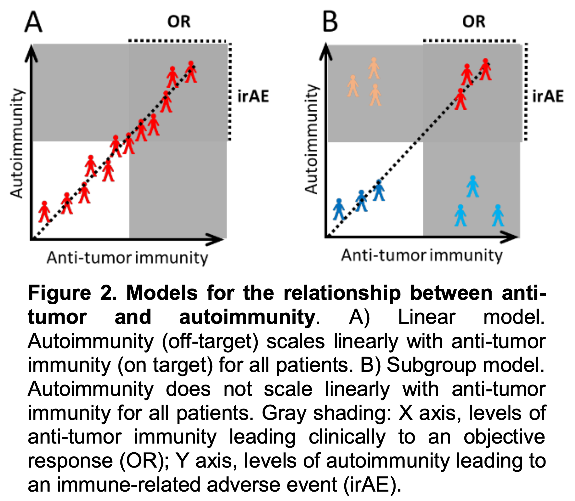
Possible association between irAE development and response to ICI complicates treatment decisions
Zhou et al. BMC Medicine (2020), for anti-PD-1 monotherapy Cook et al. JAMA Netw Open (2024)
Foster et al. Cancer (2021)
Hsiehchen et al. Oncoimmunology (2022), more so for late-onset irAEs
Ye et al. Br J Cancer (2021)
Watson et al. JAMA Netw Open (2022)
8
Notes:
Goal of course is to keep OR while minimizing irAEs, but that could be difficult given possible correlation/association, want to distinguish between the two…
Association would make sense with unleashing of previously restrained T cells… and possible shared antigens between tumor and self
Association may be more supported in cases of PD1-blockade not for CTLA-4 blockade

Slide 9
Main goals
Identify immune cell biomarkers that predict irAEs and response to ICI
Determine how ICI alters immune cell landscape
9

Slide 10
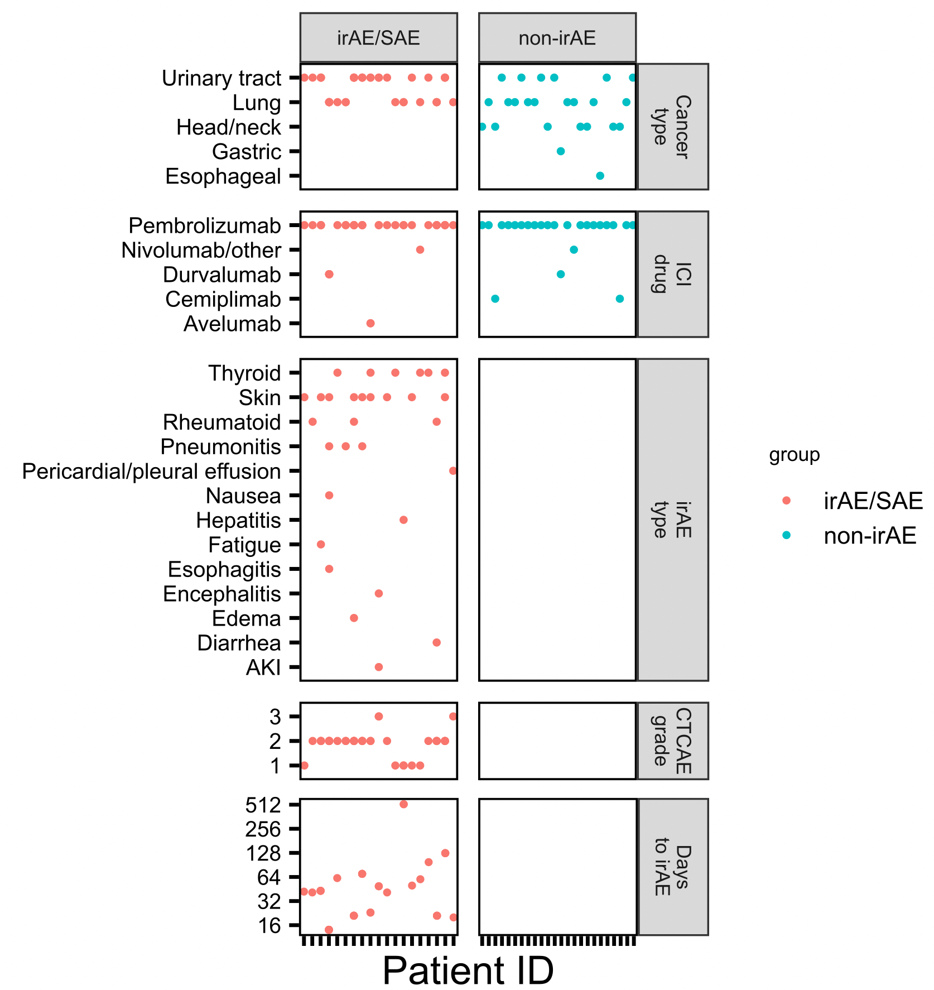
ICI cohort
mostly lung/urinary tract primary cancers
almost exclusively treated with anti PD-1
skin, thyroid irAEs well-represented
most irAEs arise within 1-2 months
10
Clinical teams at VM, SCCA, U. of Texas
Notes:
Don’t yet have OR metadata
Cancer: moreso what was available, not much melanoma at VM, + what’s treated with single class of checkpoint inhibitors + able to get large group size
ICI drug: moreso what was chosen by clinic (combination mostly for melanoma/more side effects too)
Lung approved 2nd after melanoma for PD-1 blockade
Durvalumab/avelumab are anti-PDL1

Slide 11
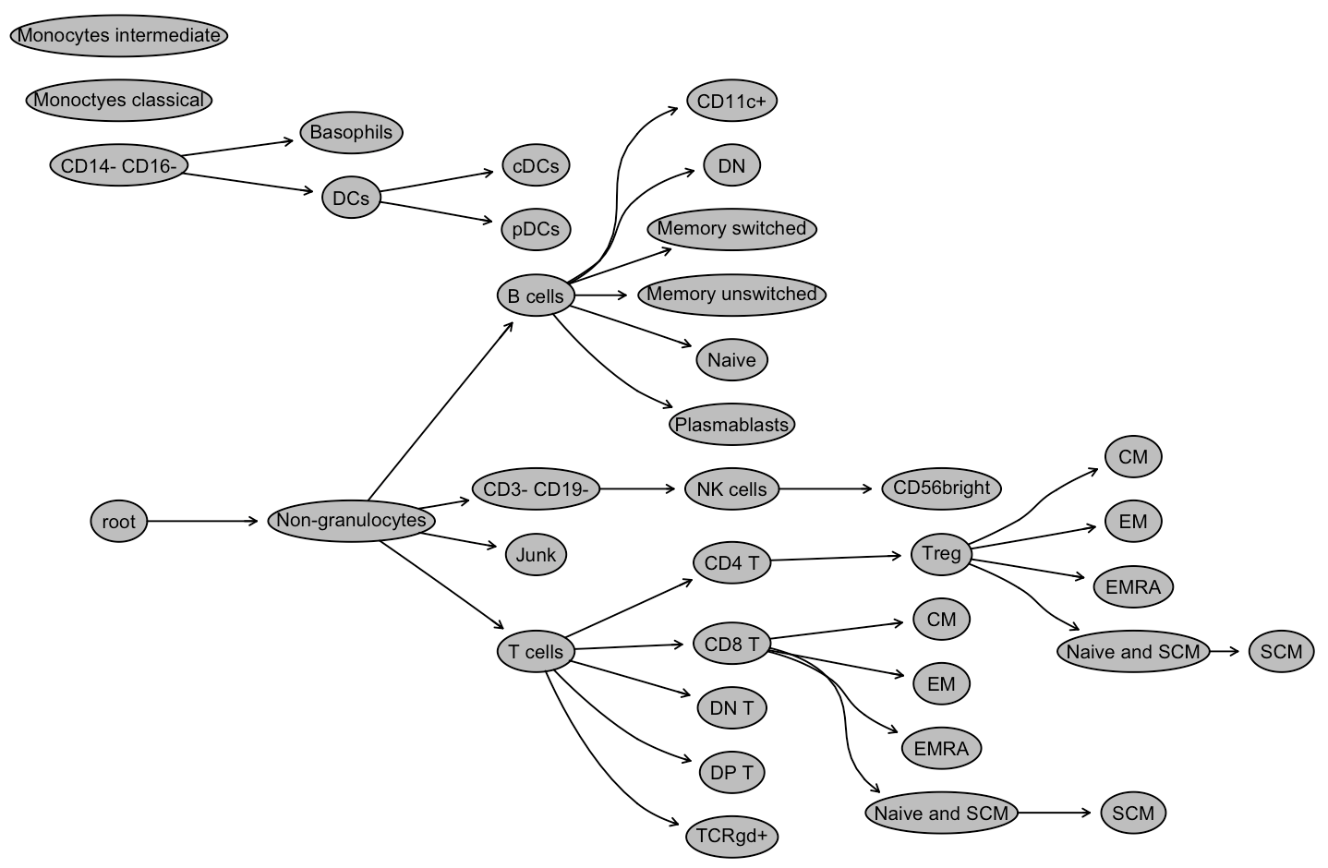
Analyzing immune cell populations in the periphery with CyTOF
Broad subsets (T, B, NK, monocytes…)
Memory subsets of T/B cells
Special CD4/CD8 subsets
PD1⁺ T/B/NK, PDL1⁺ (monocytes)
11
Alice Wiedeman
Notes:
Sample collection was a group effort done by a lot of people, collected blood from patients and froze down PBMCs
I was handed dataset from Alice W!
Was frozen PBMCs
Mass cytometry
80 reportables* (FlowJo, Alice Wiedeman)
Alice used Astrolabe cytometry cloud platform

Slide 12
Gating 80 specific immune cell subsets
12
Alice Wiedeman

Slide 13
Main goals
Identify immune cell biomarkers that predict irAEs and response to ICI
Determine how ICI alters immune cell landscape
13
Notes:
hypothesis that ICI-induced irAEs, similar to flare-ups in patients with primary autoimmunity, are symptomatic exacerbations that occur in the context of a baseline dysregulated immune state unleashed by ICI treatment.
Specifically T cells: hypothesize that freq/phenotype of T cells specific for self-antigens predicts irAE. supported by 1) published studies showing that ICI therapy targets T cells, 2) emerging evidence that ICI therapy reverses T cell exhaustion

Slide 14
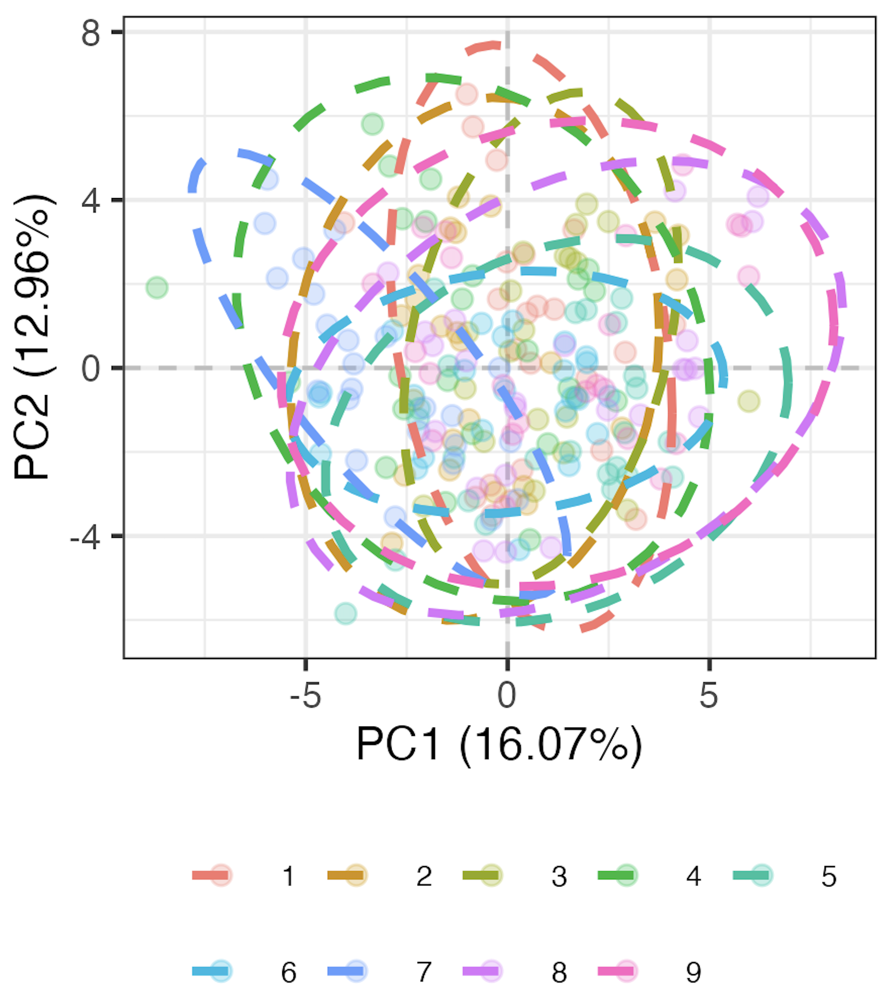
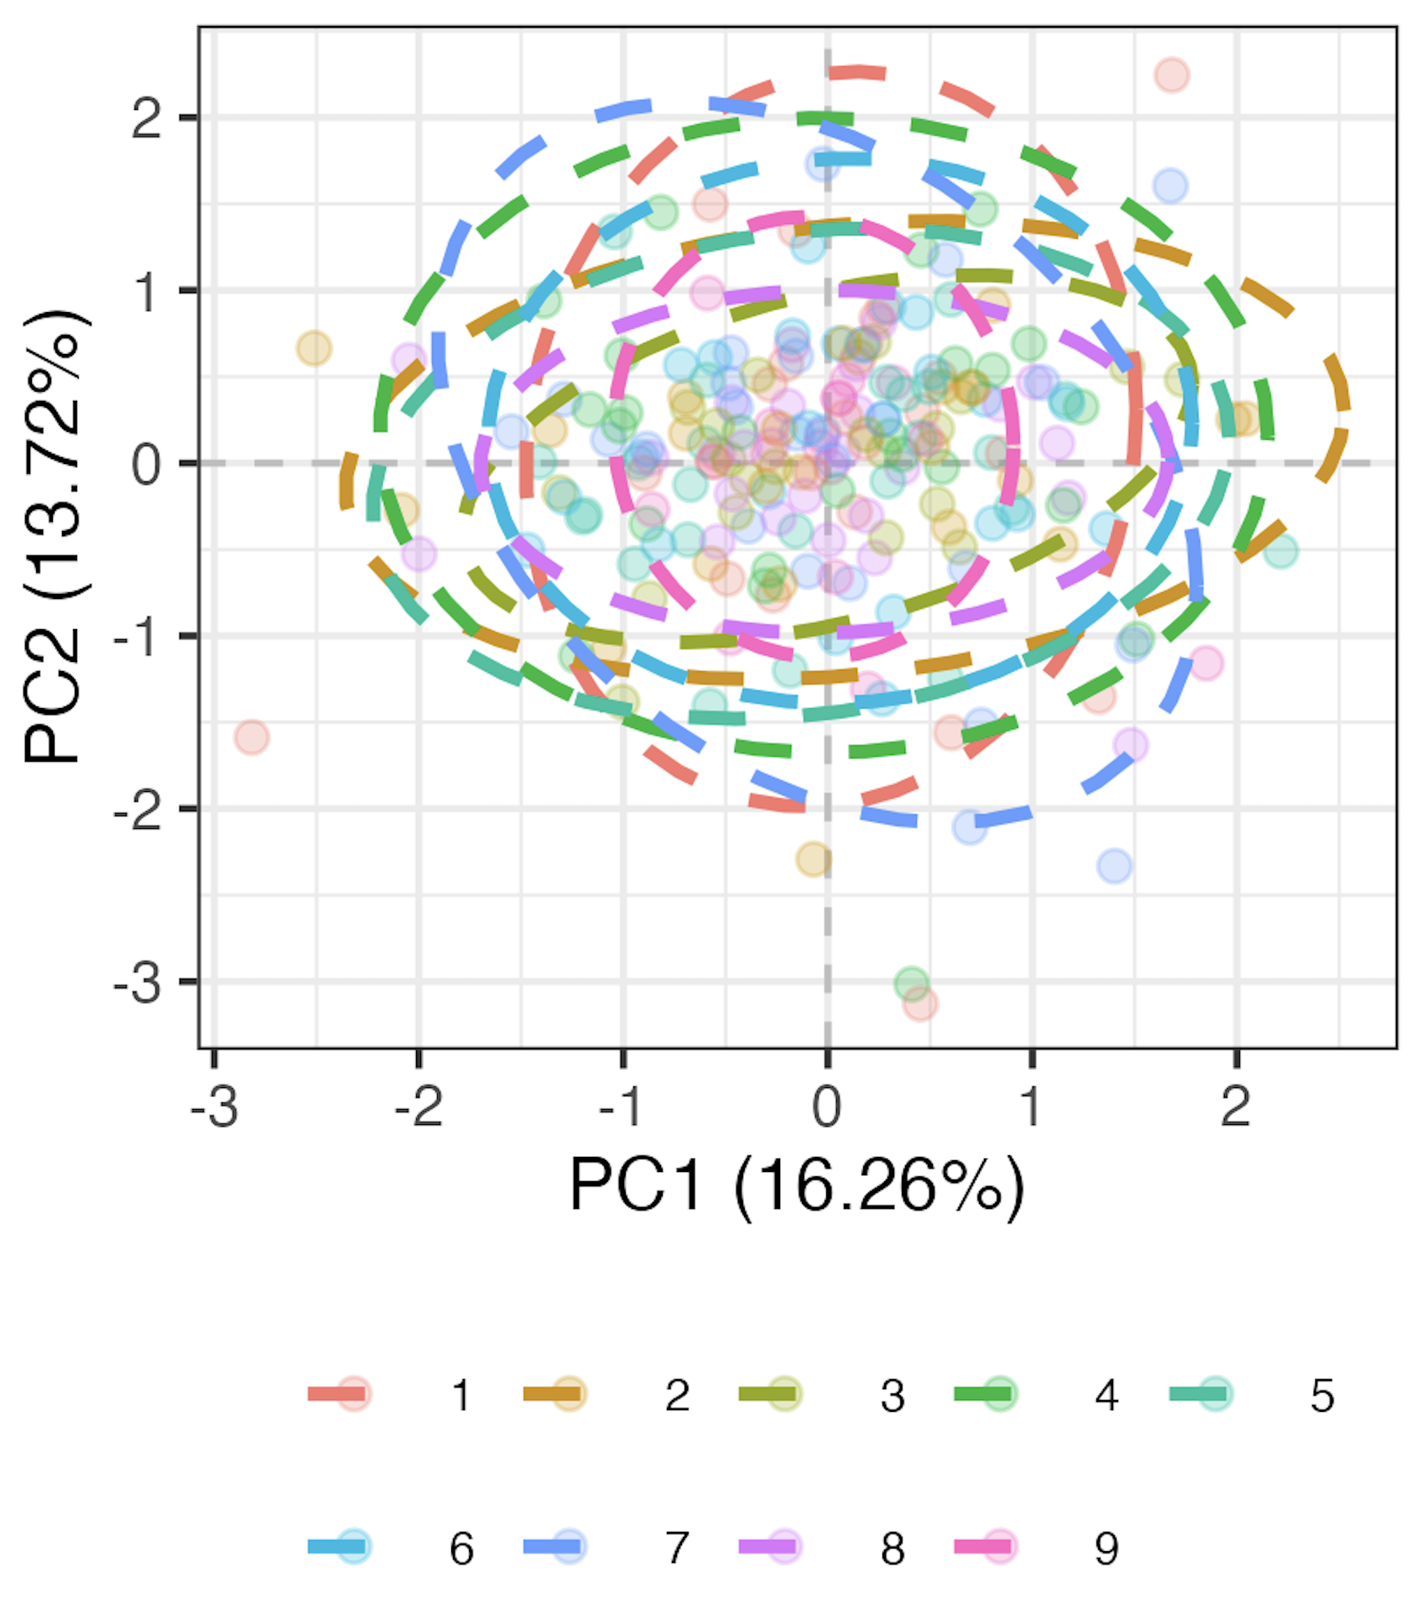
Methods for processing gated data
Remove 9 subsets with high technical variation
Transform percent of parent data to be more normally distributed
Regress out effect of batch: run linear model for each of 71 remaining subsets, take residuals as batch-corrected data
Pre-regressing out batch
Post-regressing out batch
Batch
Batch
model <- lmer(freq ~ batch + (1|patient_id))
14
Notes:
Make sure to explain well: transformation, residuals
Transform necessary as many subsequent steps assume data is normal, also reduces unequal variance/skewness
Logit transforms 0-1 to –inf, inf to normalize data
This is likely overcorrecting but no better idea (yet)

Slide 15
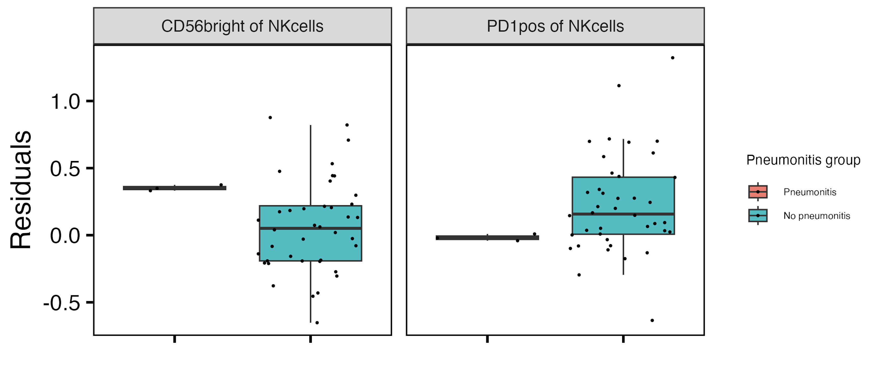
Baseline CD56^{bright} of NK cells frequency higher, PD1⁺ of NK cells frequency lower in those developing pneumonitis
**
**
15
**: padj < 0.01
Notes:
This is strongest single feature baseline result
CD56bright NK are abundant cytokine producers but only weakly cytotoxic before activation, PD1+ NK presumably more inhibited…, so these trends could sense with more active → more irAE and more inhibited → less irAE BUT that doesn’t really fit with longitudinal decrease in CD56bright of NK in irAE group…
Only CD56bright of NK result holds if including pleural effusion in pneumonitis group

Slide 16
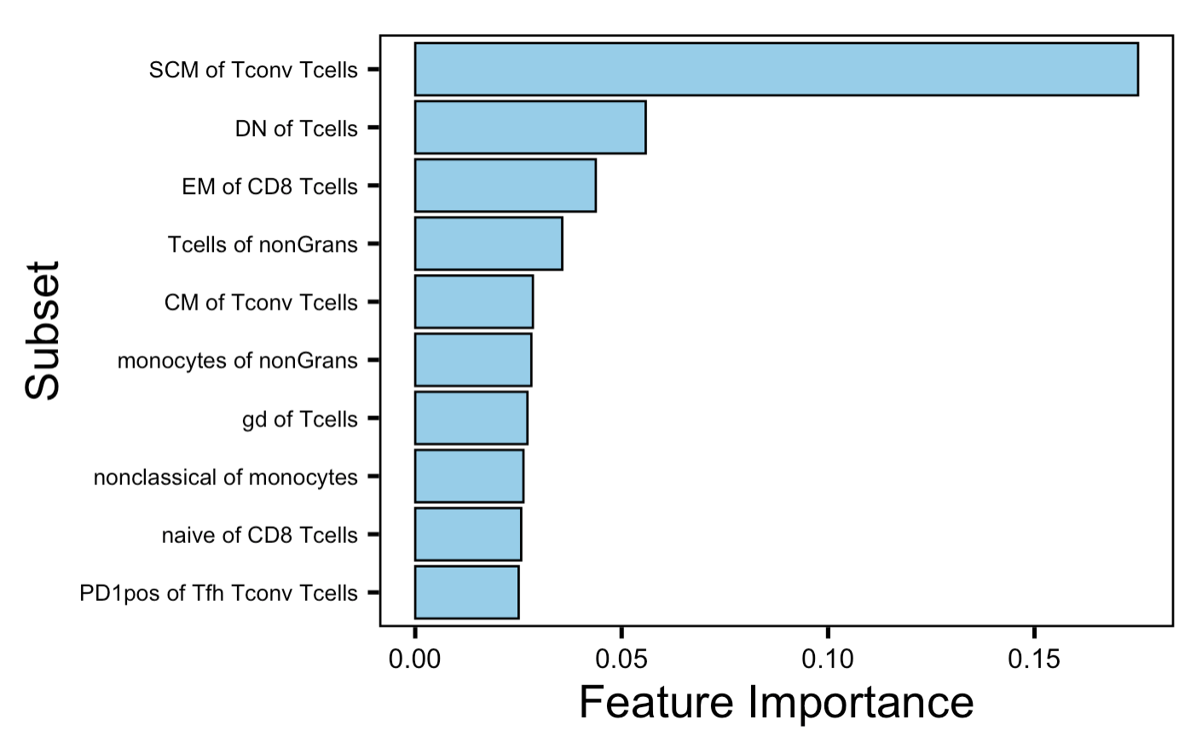
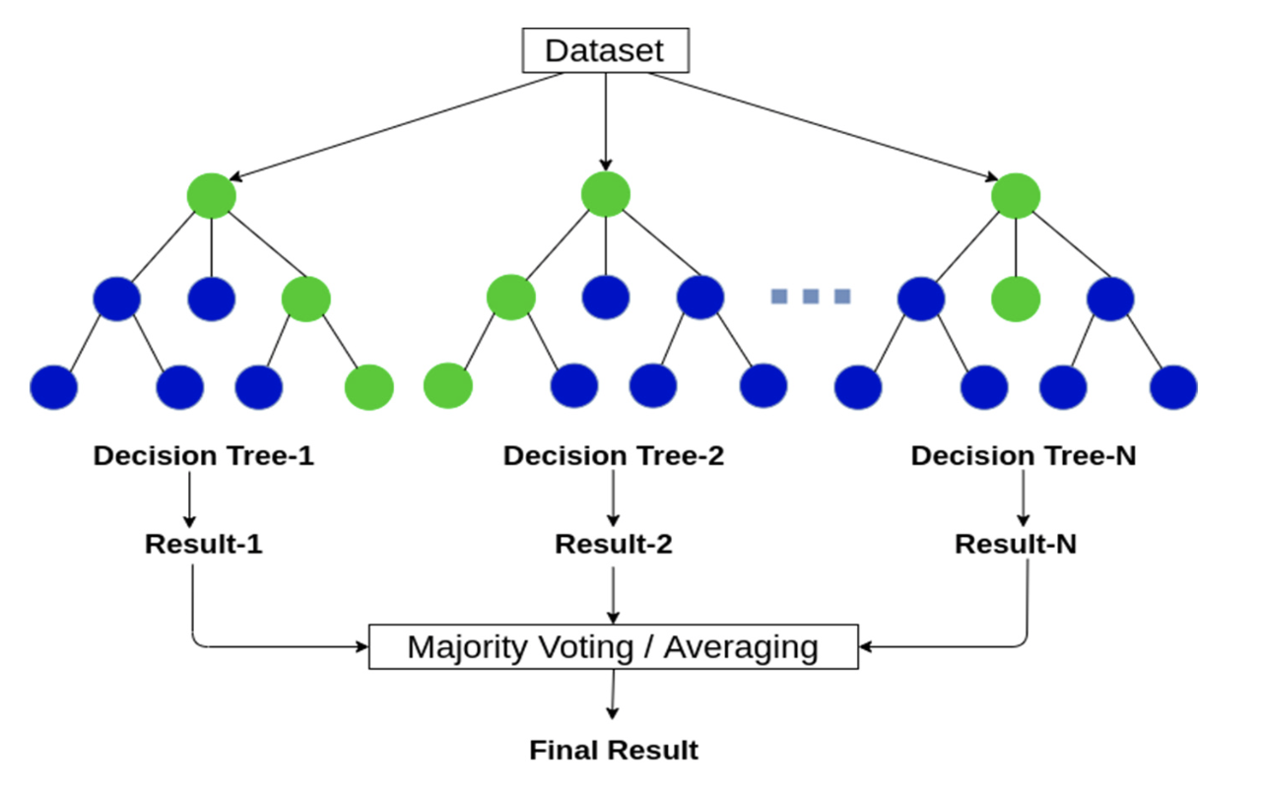
Methods for baseline subset modules: combined irAE group comparison
Use random forest models to order subsets by importance in combined irAE group distinction
Take top 4 subsets as top subset module
PCA only using subsets in the module
16
Anas Brital
Notes:
Supervised machine learning
Multiple decision trees to classify data
Train model with subset freqs and irAE group labels
Each decision tree makes splits based on random subsets of features/data, predictions combined through majority voting
Feature importances determined by how much each feature reduces prediction error across trees (features that consistently reduce error are more important, more influential in distinguishing irAE groups)
ROC AUC 0.83 for validation, 0.75 for test, accuracy/precision 0.66 for both
For subsets with < 5% NAs, replace NAs with mean
random forest modules may be more robust, maybe more recapitulated in other datasets... that can explain differences between them and original modules (more likely over fit)
Should also emphasize that modules are somewhat arbitrary in sense that multiple different configurations of mostly same subsets would likely work for each module approach taken here

Slide 17
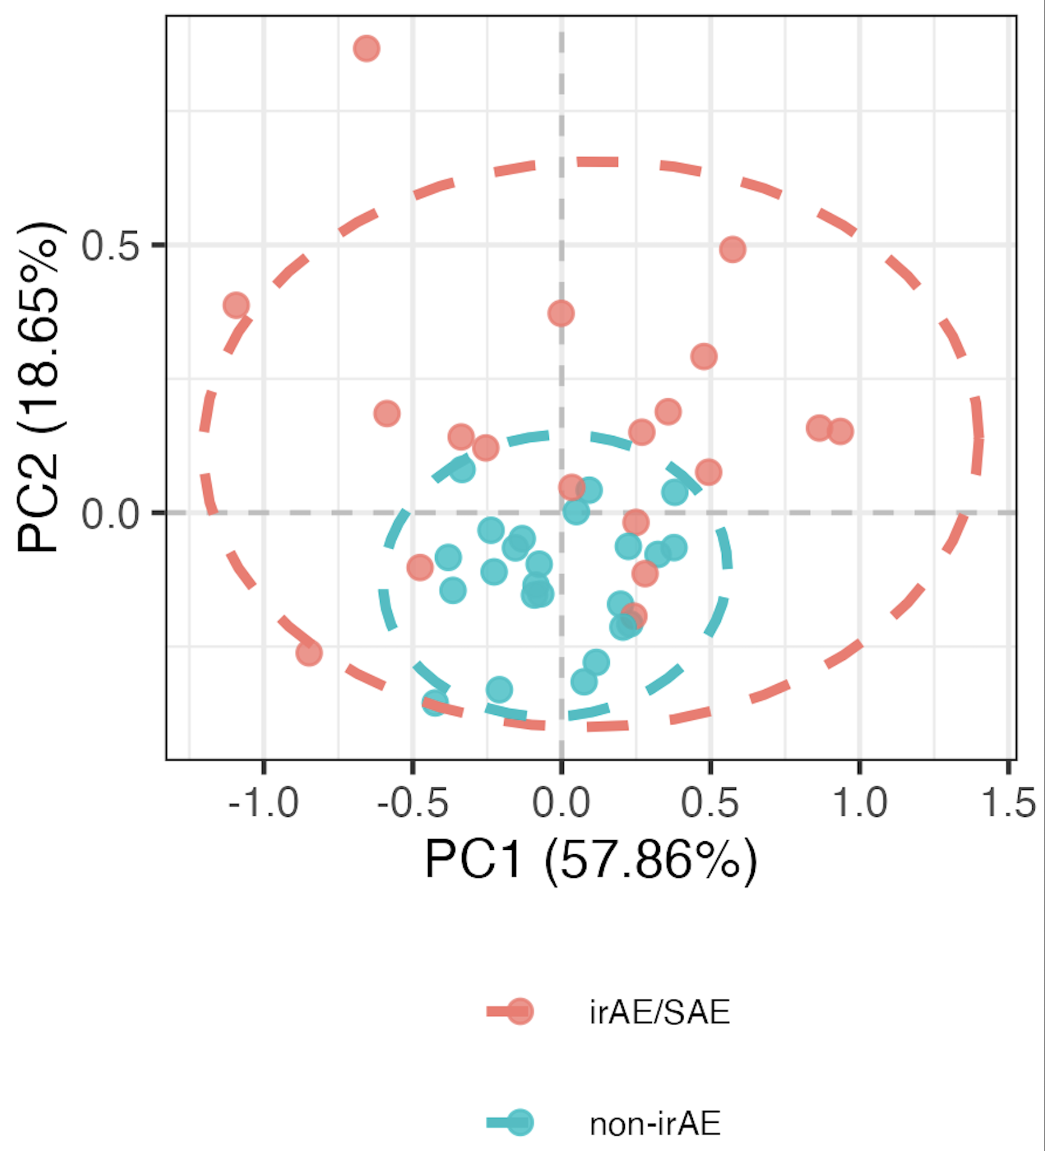
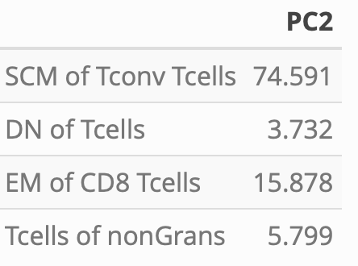
Distinguishing combined irAE group using random forest-derived module of top 4 combined irAE baseline subsets
PC2 weights
PC2 **
17
**: p < 0.01

Slide 18
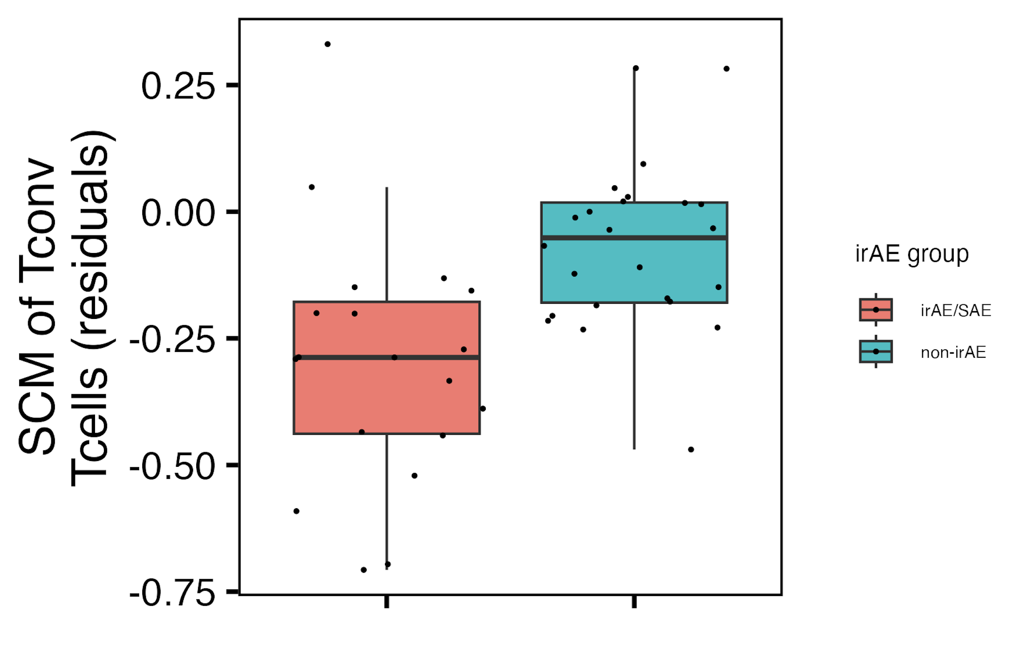
Baseline SCM of T_{conv} T_{cells} frequency may be lower in those developing an irAE
18
padj = 0.1
Notes:
This may be unexpected… expected SCM to be associated with pathogenic autoimmunity

Slide 19
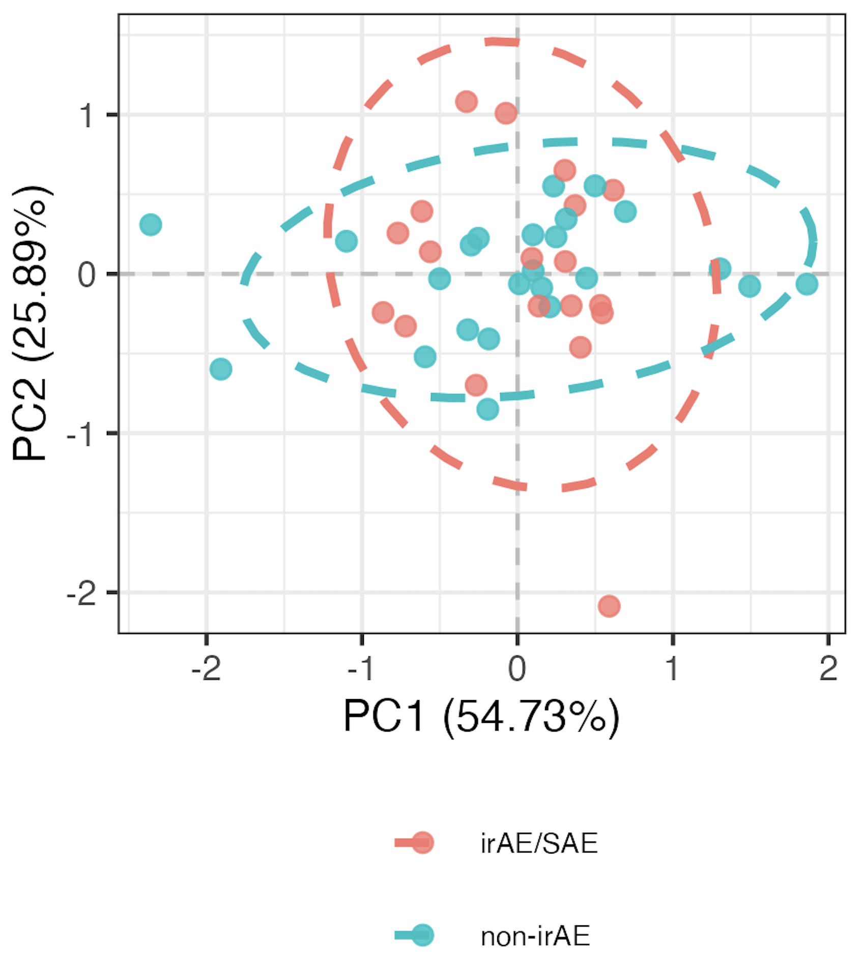
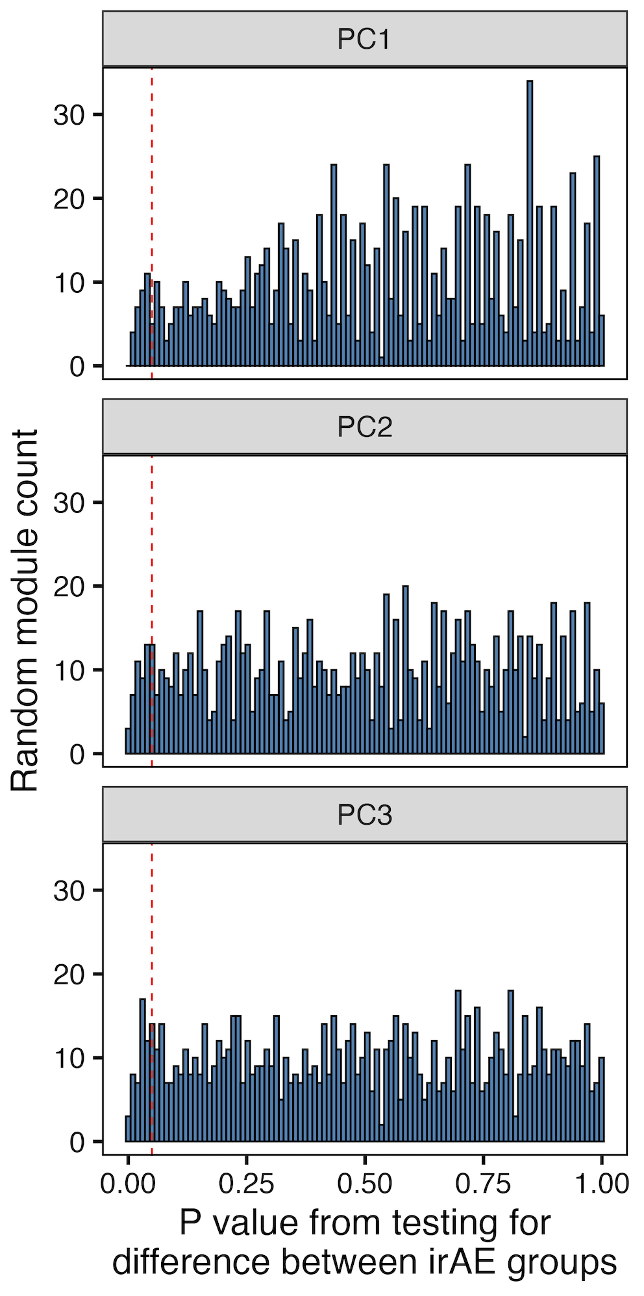
Distinction of combined irAE group using module of top 4 combined irAE baseline subsets unlikely due to chance
bottom 4 subset module
n.s. in PCs 1-3
19
Notes:
~4% of randomly formed modules have similar/better separation in PCA space, so this equates to a Monte Carlo pvalue of 0.04 which means that the observed separation using the top module on the previous slide is not likely due to random chance
SCM subset most common in sets of 4 that hit significance, not surprisingly given it’s a borderline pval itself…

Slide 20
Methods for baseline subset modules: specific irAE group comparisons
For each subset, test for difference in baseline frequency distributions between irAE groups
Arrange subsets by p value
Take top 4 subsets as top subset module
PCA only using subsets in the module
20
Notes:
For subsets with < 5% NAs, replace NAs with mean
Should also emphasize that modules are somewhat arbitrary in sense that multiple different configurations of mostly same subsets would likely work for each module approach taken here

Slide 21
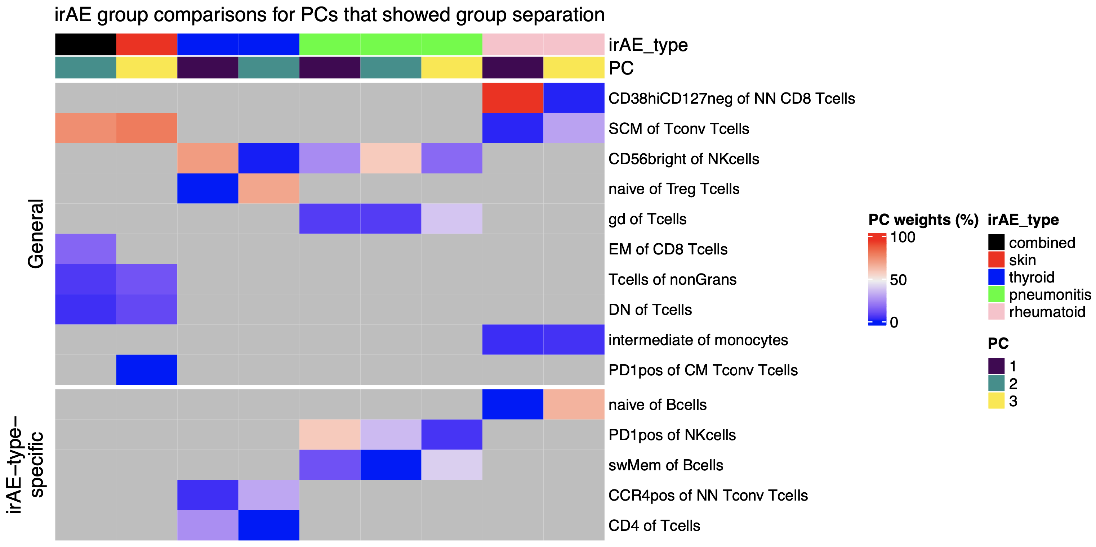
Summary of baseline module analyses: several subsets may be more irAE-type-specific
*
*
Grey means NA (subset not in top module for that irAE group comparison)
21
Notes:
Worth raising concern of overfitting to our data (i.e. subsetting subsets ~arbitrarily), but the non-specific subsets with literature evidence are perhaps more backed up here (less biased by noise)
Only showing PCs with p < 0.05 for group comparison

Slide 22
Main goals
Identify immune cell biomarkers that predict irAEs and response to ICI
Determine how ICI alters immune cell landscape: what immune cell subsets change in irAE group-specific manner on ICI?
22

Slide 23
Methods to identify immune cell subsets changing over ICI in irAE group-specific manner
Remove PD1⁺ subsets (detection blocked by anti-PD-1 therapeutic Abs)
For each subset
Model relationship between subset frequency and time (since baseline) with or without interaction between irAE group and time (bolded)
Run ANOVA on two models to see if including interaction term improves model fit
model <- gam(freq ~ irae_group +
s(days_from_baseline, k = 5, bs = "cr", by = irae_group) +
s(patient_id, bs = "re"), data = data, method = 'REML')
23
Notes:
If model fit improves with interaction term (which ANOVA is testing), that means that the effect of time on ICI on subset frequency is different between irAE groups
Null hypothesis: The model without interaction (i.e., the simpler model) fits the data as well as the model with the interaction.
Alternative hypothesis: The model with the interaction term fits the data significantly better than the model without it, suggesting that the effect of days_from_baseline differs between groups.
REML (Restricted Maximum Likelihood) is a statistical technique used for parameter estimation, particularly in mixed-effects models and generalized additive models (GAMs)

Slide 24
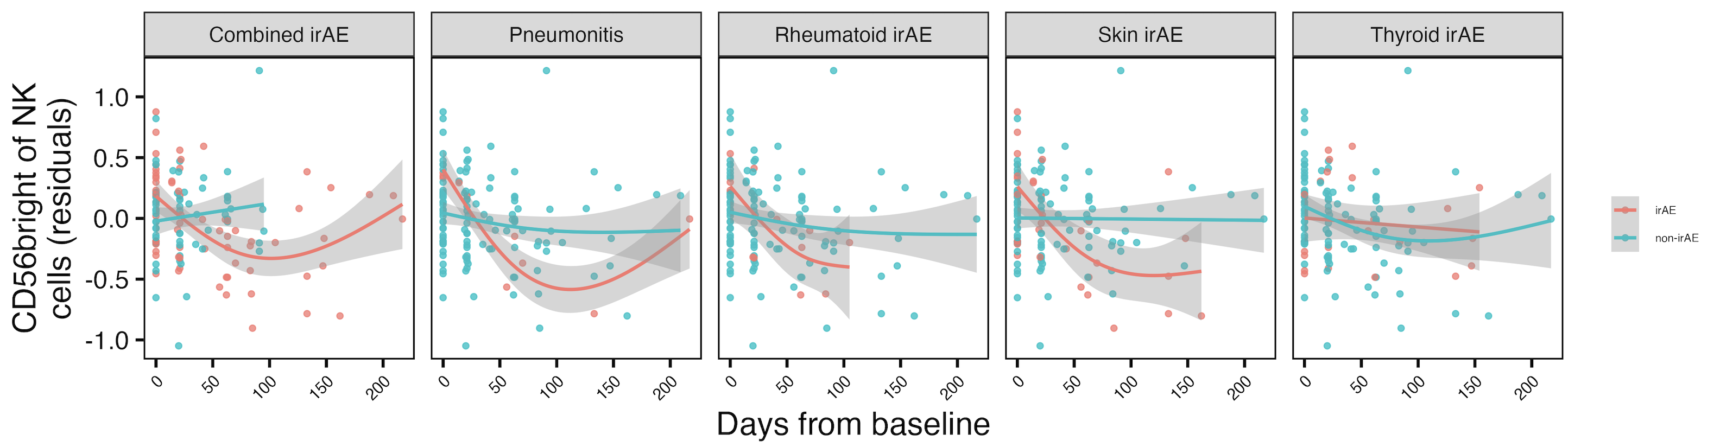
Frequency of CD56^{bright} of NK cells decreases early with ICI in most irAE group comparisons
**
n.s.
n.s.
*
n.s.
CD56^{high} NK of non-granulocyte frequency reported lower in severe irAE patients at irAE time (Kovacsovics-Bankowski et al. J Immunother Cancer. 2024)
24
**: padj < 0.01, *: padj < 0.05
Notes:
Most robust longitudinal result
Note that remember from cohort metadata plot most irAEs arise within 1-2 months, so that’s within early timing here where we see differences
matches finding from Kovacsovics-Bankowski et al. J Immunother Cancer. 2024 (lower CD56high NK of non-gran in patients at irAE max), surprisingly despite their cohort was mostly not pulmonary irAE and was mostly melanoma

Slide 25
Summary
At baseline, a few subsets differ between those developing and not developing pneumonitis; multiple subsets needed to distinguish combined and other irAE types
Over ICI, the frequency of CD56^{bright} of NK cells decreases in most patients who develop an irAE
Some subsets may be more irAE-type specific
25
Notes:
irAE-type-specific subsets, like CD56bright/PD1+ of NK for pneumonitis (and SCM of Tconv being more general maybe for combined irAE)
Cancer types important, as that (in addition to irAE types) will likely help explain differences in results between here/public reports (memory CD4 T cells may be more predictive in patients with melanoma while CD8 effecter T cells maye be more associated with a lung cancer population)
Different subsets maybe are irAE-type-specific due to different immune microenvironments of different organs
Presumably longitudinal results that are group specific come from effects on PD1+ cells that then affect these other subsets we are actually measuring…

Slide 26
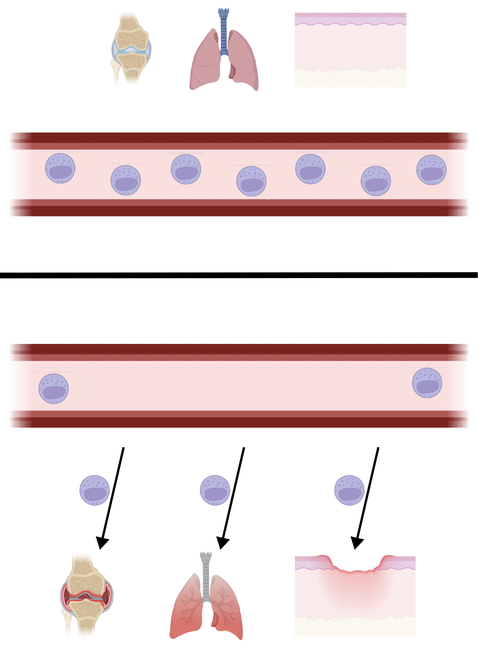
Model: early on ICI, CD56^{bright} NK cells traffic out of periphery to irAE sites where they contribute to pathology
CD56^{high} NK of non-granulocyte frequency reported lower in periphery in severe irAE patients at irAE time (Kovacsovics-Bankowski et al. J Immunother Cancer. 2024)
NKs in synovium of RA patients exhibit CD56^{bright} phenotype (Pridgeon et al. Rheumatology 2003)
CD56^{bright} subset of NKs greatly expanded within inflamed joints of patients with inflammatory arthritis (Dalbeth & Callan Arthritis & Rheumatology 2002)
CD56^{bright} NK cells enriched at inflammatory sites in variety of diseases (Dalbeth et al. J Immunol 2004)
CD56bright NK cells accumulate in psoriatic skin and exacerbate inflammation (Ottaviani et al. Eur J Immunol 2006)
Pre-ICI
Post-ICI in patients developing irAEs
26
bioRender
Notes:
Changes in PD-1+ cells being here (potentially) signaling changes, chemokine production changes, recruitment signal changes.
And maybe higher baseline levels means larger reservoir to traffic out and cause damage?

Slide 27
Next steps
IMPACD to look at more granular cell subsets
Over ICI, do immunotypes become more “AID-like” specifically in irAE group?
27
Notes:
IMPACD stage 2 gating is what I am referring to I believe for more granular subsets: performs exhaustive permutational analysis of all markers. This resembles what we just did for stage 1, but instead of stopping after the first node, in stage 2 we will keep adding more and more nodes until a specified depth is reached.
Alice W. working on single-param gates to send my way
Public data test is likely ~complicated by needing similar cohorts to see same effects
But public data test would be very important given concerns of overfitting… for the module analysis

Slide 28
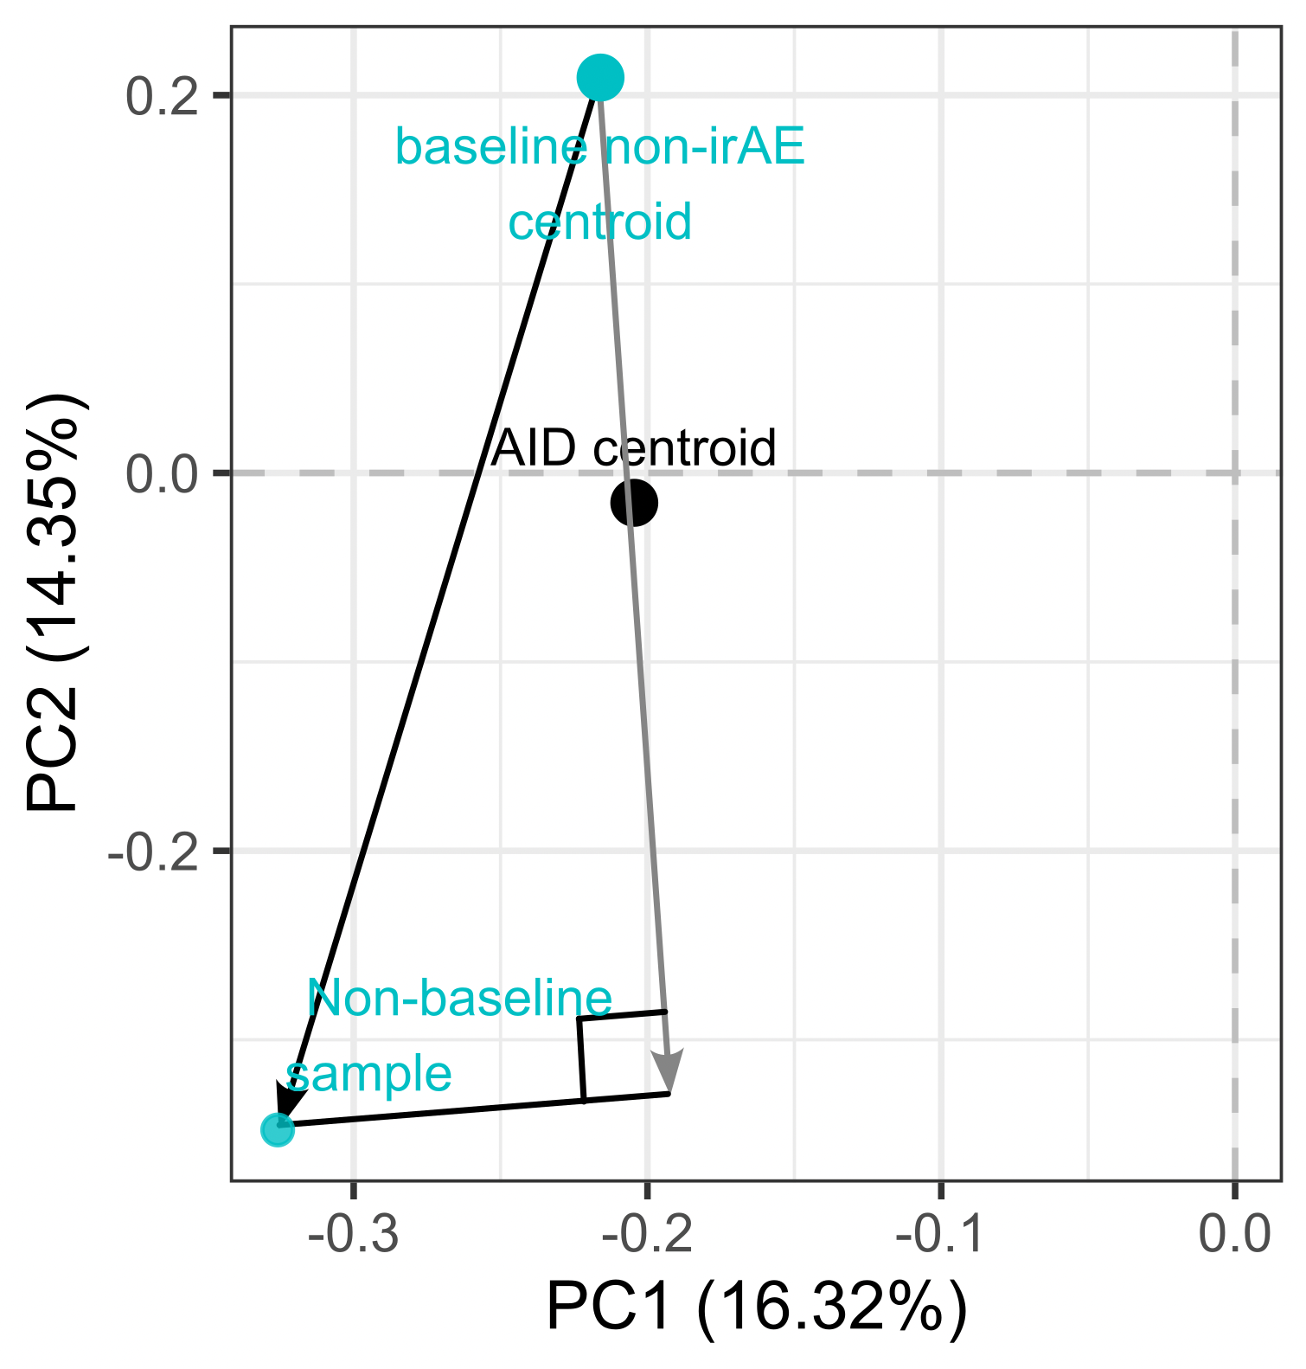
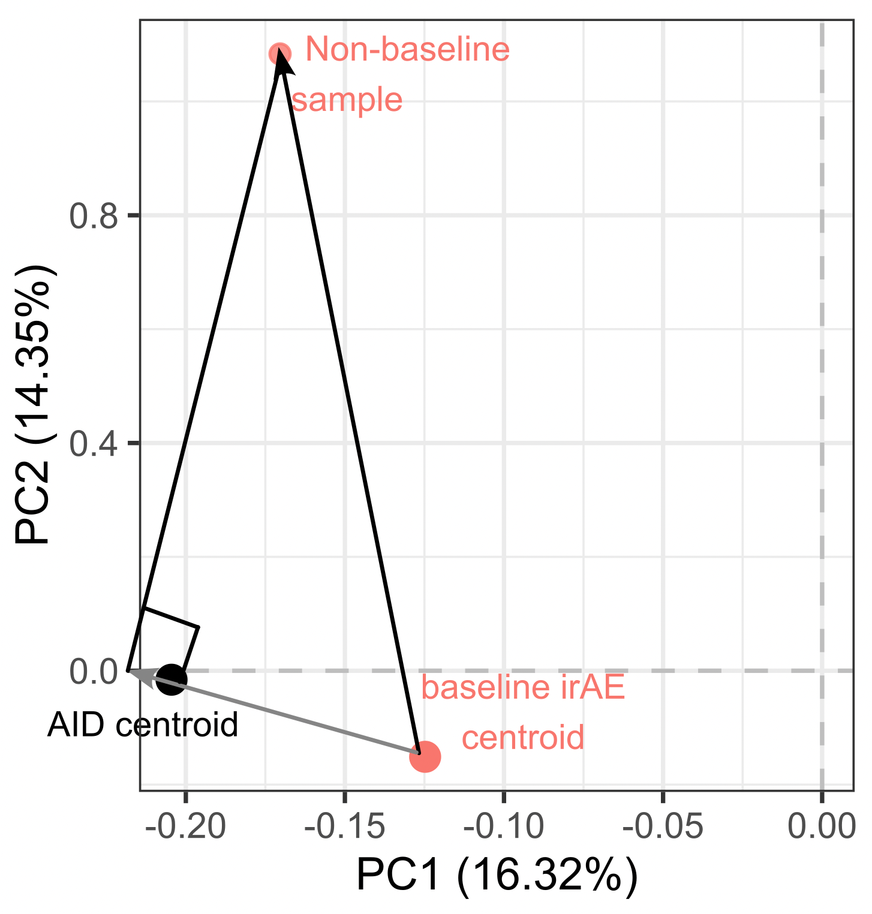
Over ICI, do immunotypes become more “AID-like” specifically in irAE group?
non-irAE example
irAE example
28
Grey lines show components of ICI effects in direction of AID, are these more positive in irAE group?
Notes:
Remove PD1⁺ subsets
Find centroids of autoimmune and baseline cancer data (for irAE/no irAE groups) in original high dimensional space
Define lines from baseline cancer centroids (irAE/no irAE ones) to/through autoimmune centroid
For each patient for each longitudinal sample, draw line from their baseline group centroid to that data point
Find component of those lines (step 4) in baseline-AID line (step 3), more positive meaning more in direction of AID immunotype
Longitudinal data, draw schedule: visits 2/3 after 1st/2nd infusion (ICI)
So we’re doing projection of vector from cancer baseline centroid to longitudinal point, projection of that onto vector from centroid of baseline cancer to AID centroid
Hard to say but would be important/nice to know at what projection value they’ve “passed” the AID centroid… which may or may not be biologically interesting…

Slide 29
Inhibitory immune checkpoints help maintain self tolerance
Khan et al. Semin Cancer Biol. 2020
Notes:
Script:
Immune checkpoint molecules are ligand-receptor pairs that exert stimulatory or inhibitory effects on the immune response
Inhibitory checkpoints are crucial for maintaining self-tolerance and modulating the duration and magnitude of the immune response to minimize tissue damage
CTLA-4 and PD-1/PD-L1 are the most widely studied inhibitory checkpoint molecules.
CTLA-4 outcompetes CD28 (costimulatory receptor) for B7-1/2 ligands on APCs to increase threshold for T cell activation (i.e. reduces immune responses to weak antigens, self/tumor)
PD-1 expressed by activated/induced T cells; this checkpoint prevents inappropriate overactivation and limits duration of T cell activation

Slide 30
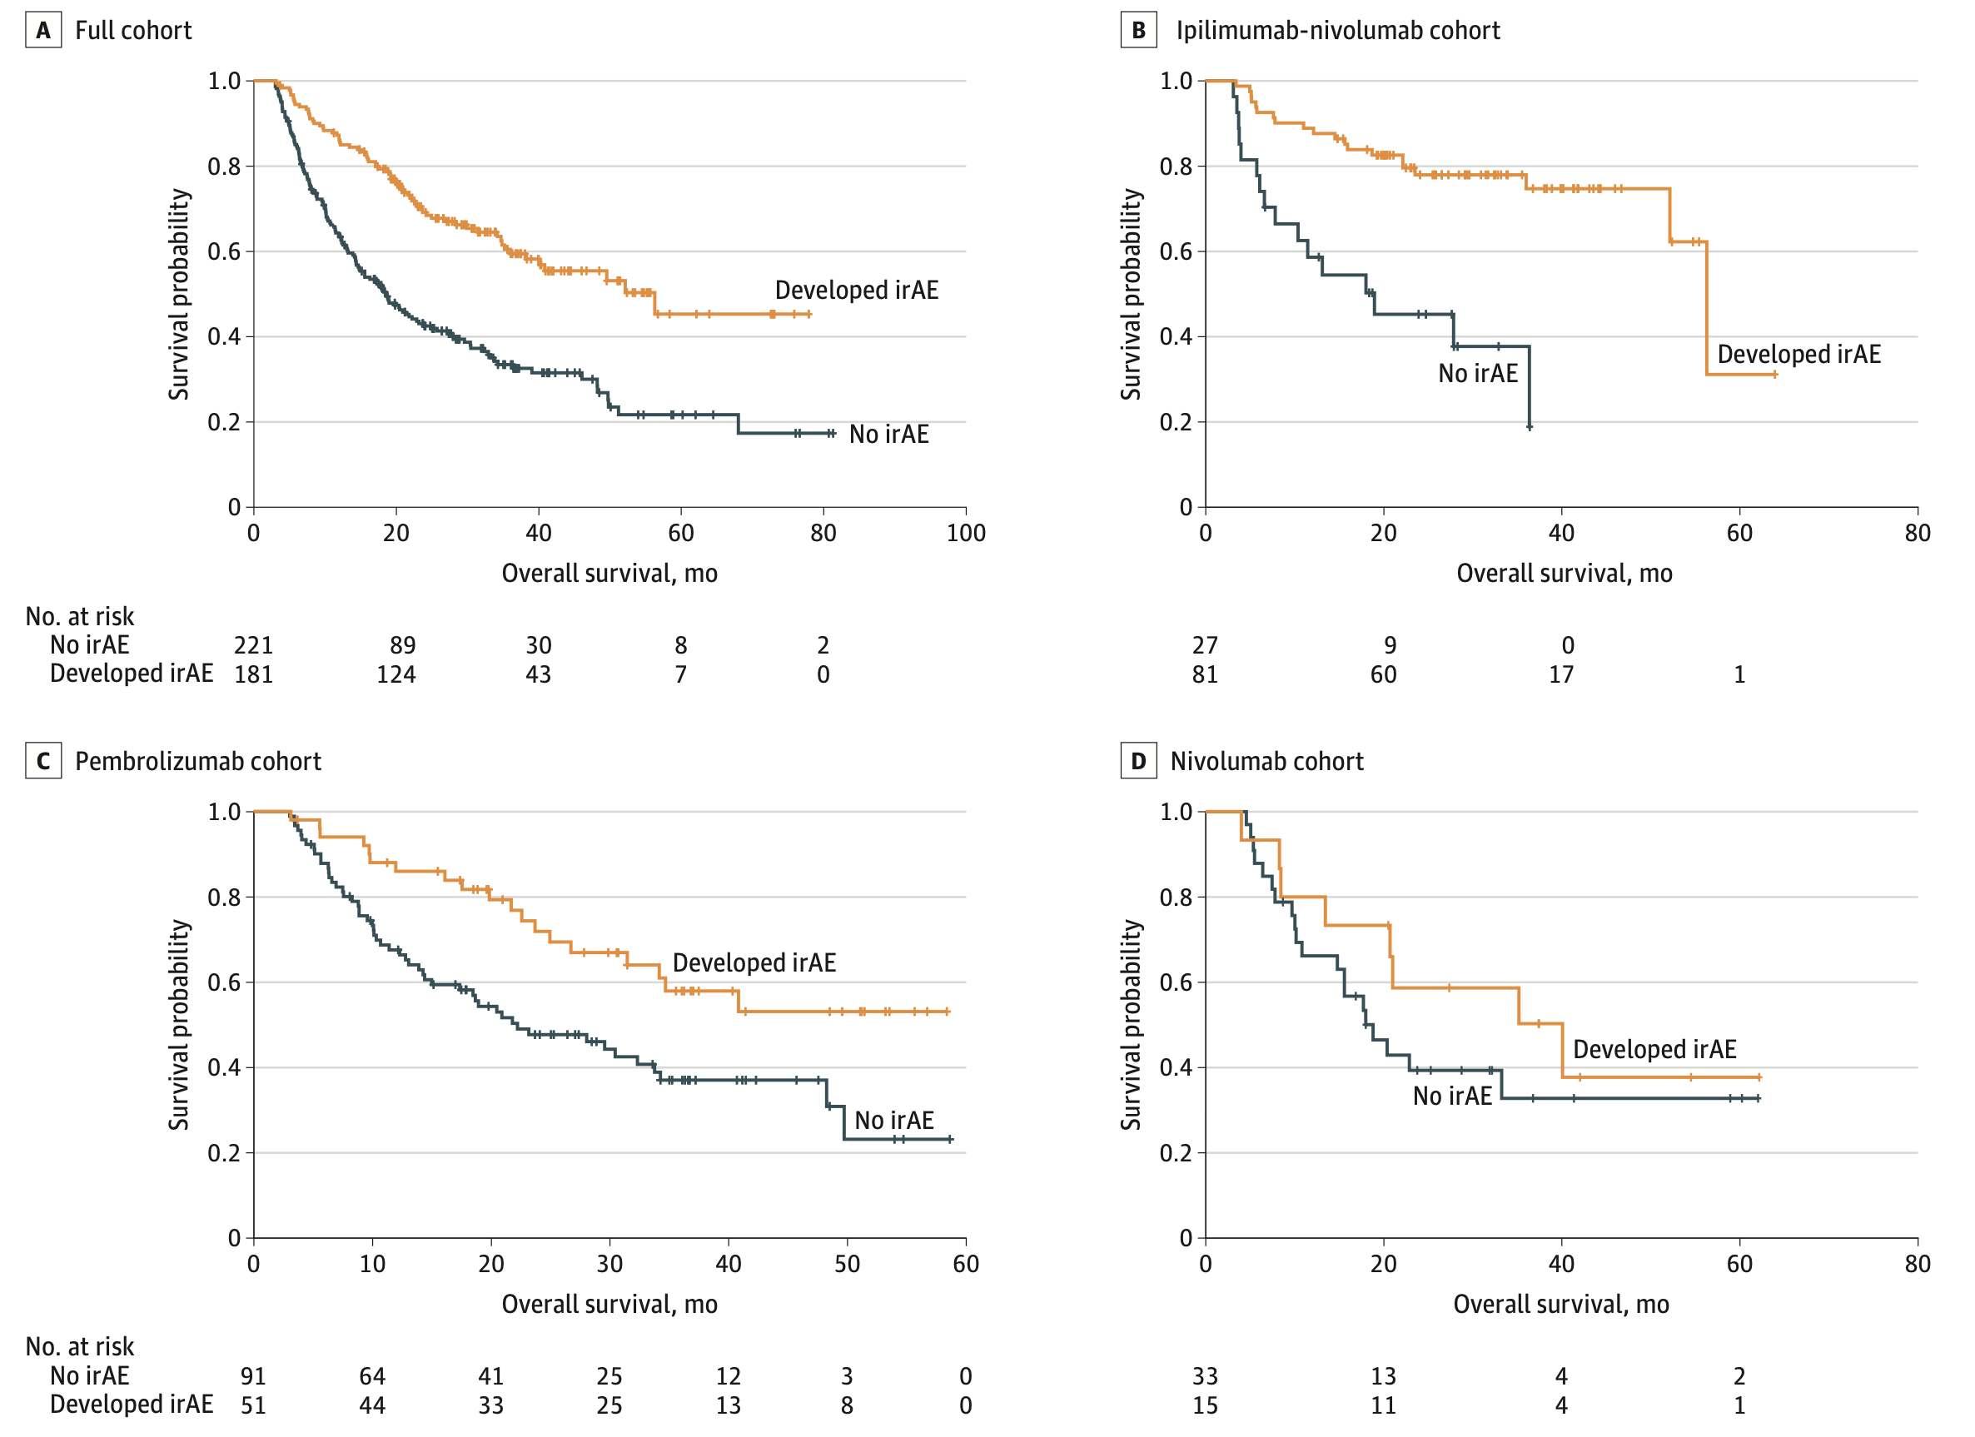
irAE development is associated with anti-tumor response (PMID31021392, PMID26501224, PMID26446948)
Watson et al. JAMA Netw Open. 2022
Notes:
Association of checkpoint inhibitor-induced toxic effects with shared cancer and tissue antigens in non-small cell lung cancer:
irAEs associated with response to therapy (also can cite Association of vitiligo with tumor response in patients with metastatic melanoma treated with pembrolizumab), also Nivolumab in resected and unresectable metastatic melanoma: characteristics of immune-related adverse events and association with outcomes
Characterization of anti-cancer immune response associated with immune-related adverse events in patients with kidney cancer (meeting abstract)
- more irAEs in ICB responders, not a new finding

Slide 31
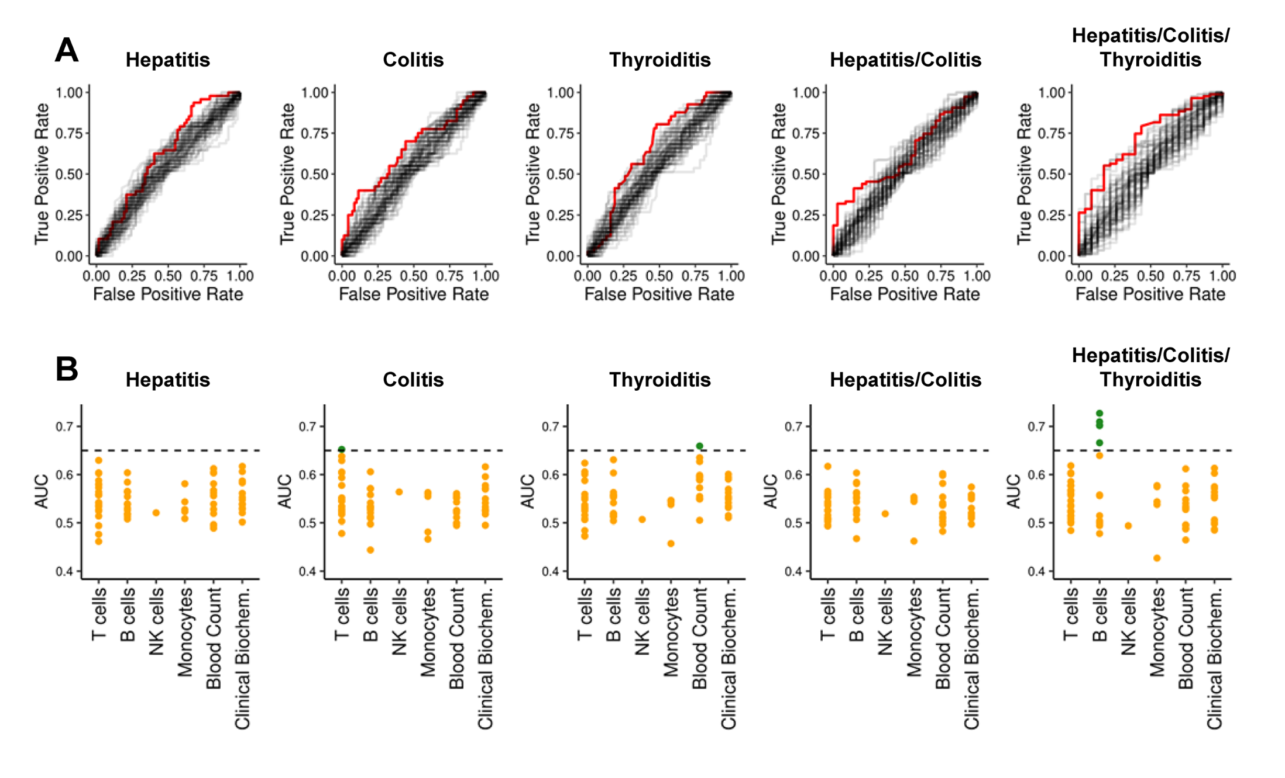
Pre-therapy data generally struggle to reliably predict irAE risk
AUCs for previously reported biomarkers and clinical parameters (68)
Glehr et al. Front Immunol. 2022
Notes:
Biomarkers associated with irAE have also been described, including IL-17 levels, gene expression signatures and levels of eosinophils, but hard to predict specifically from pre-therapy data
An AUC of 0.5 suggests no discrimination (equivalent to random guessing), while an AUC of 1 indicates perfect discrimination (for predicting irAE)

Slide 32
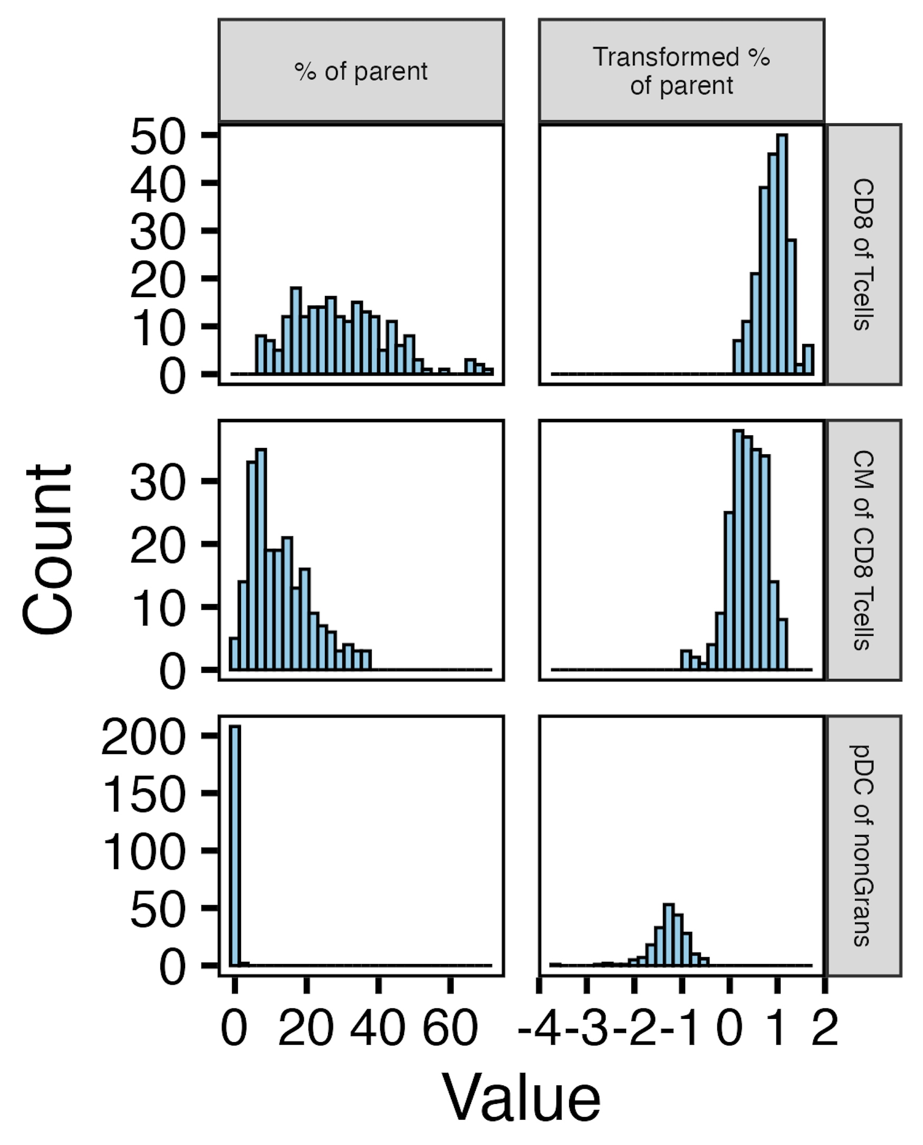
Data pre/post transform

Slide 33
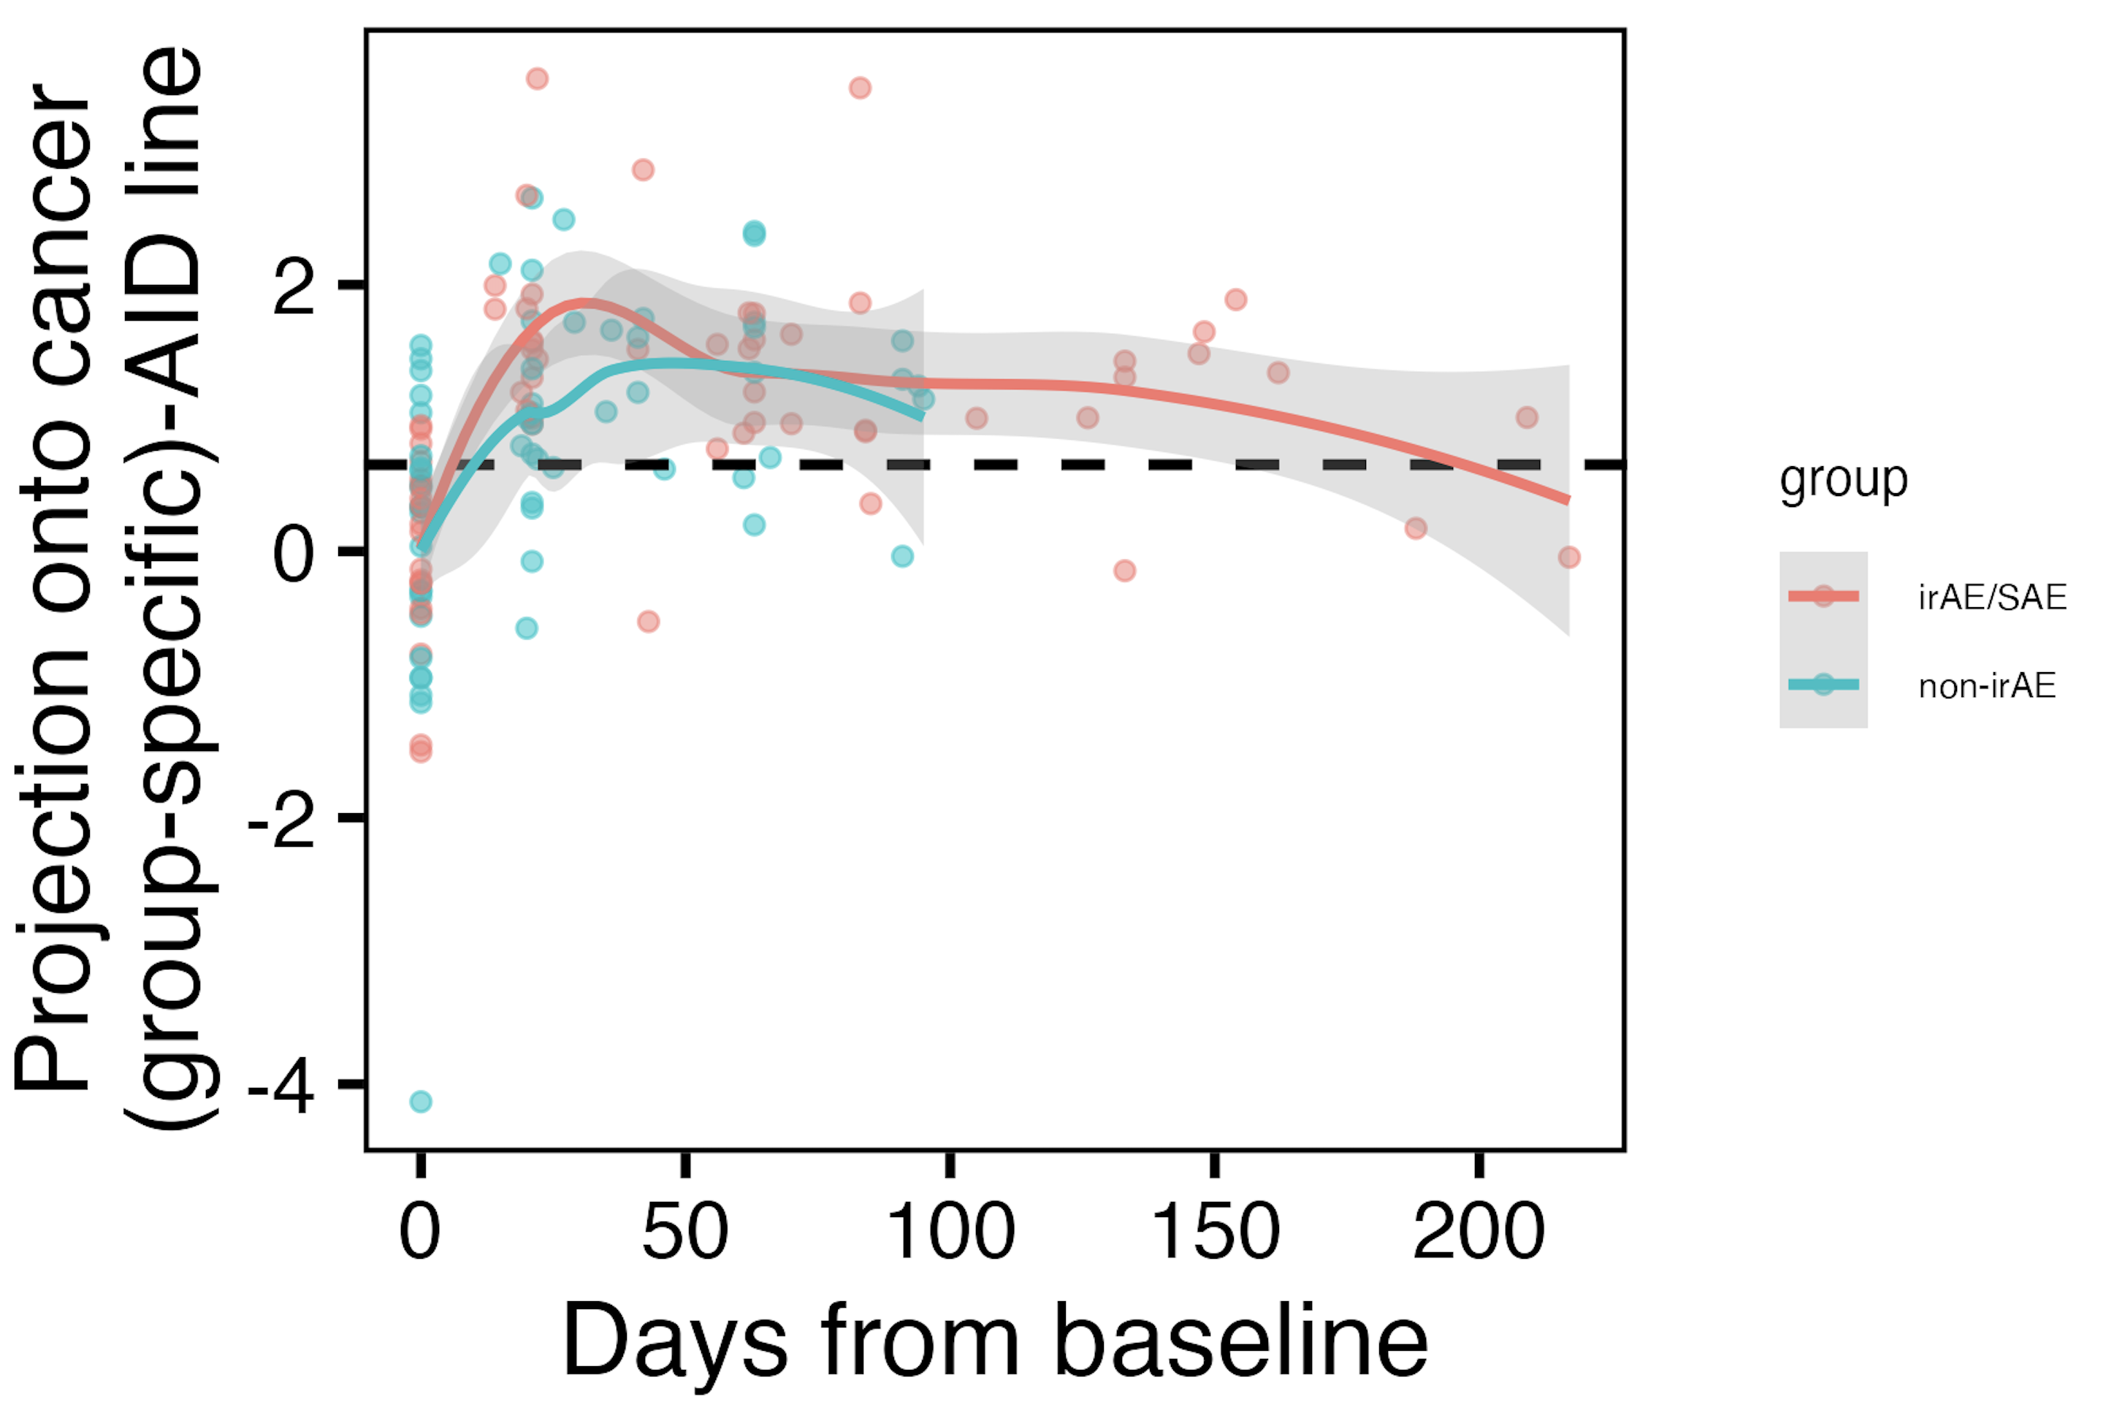
Immunotypes of irAE group do not clearly become more “AID-like” over ICI than those of non-irAE group
Dotted line showing baseline cancer centroid-AID centroid distance
n.s.
Notes:
THIS IS NOT SIGNIFICANT, BUT MAY BE INTERESTING NONTHELESS?
Note that remember from cohort metadata plot most irAEs arise within 1-2 months, so that’s within early timing here where we see differences
And the fact that you can see returning to baseline in the late timepoint data makes sense I think
positive means closer to AID centroid
Hard to say but would be important/nice to know at what projection value they’ve “passed” the AID centroid… which may or may not be biologically interesting…

